Slide 1
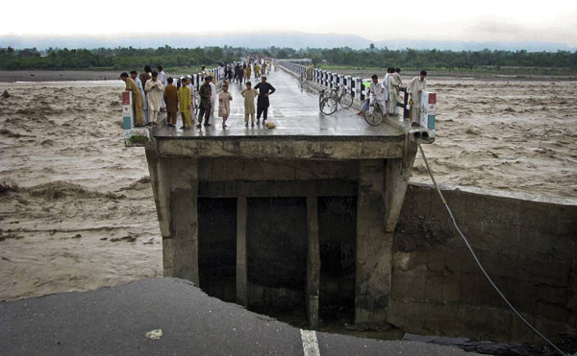


Markets analysis in Preparedness, Relief and Recovery
On the job training
Dhaka, Bangladesh
December 6-15, 2015
This training pack was designed by
Oxfam, and funded by ECHO.
Notes:
Photo credit: Unknown, downloaded from http://www.coolpicturegallery.net/2010/08/photos-of-floods-in-pakistan.html
Opening Remarks, then move right to the string game or wealth ranking game: 20 Minutes
Transition to introductions game: 10 minutes
Total time: 30 mins
Ben leads

Slide 2
Introduction to Market Baseline Training and Assessment

Slide 3
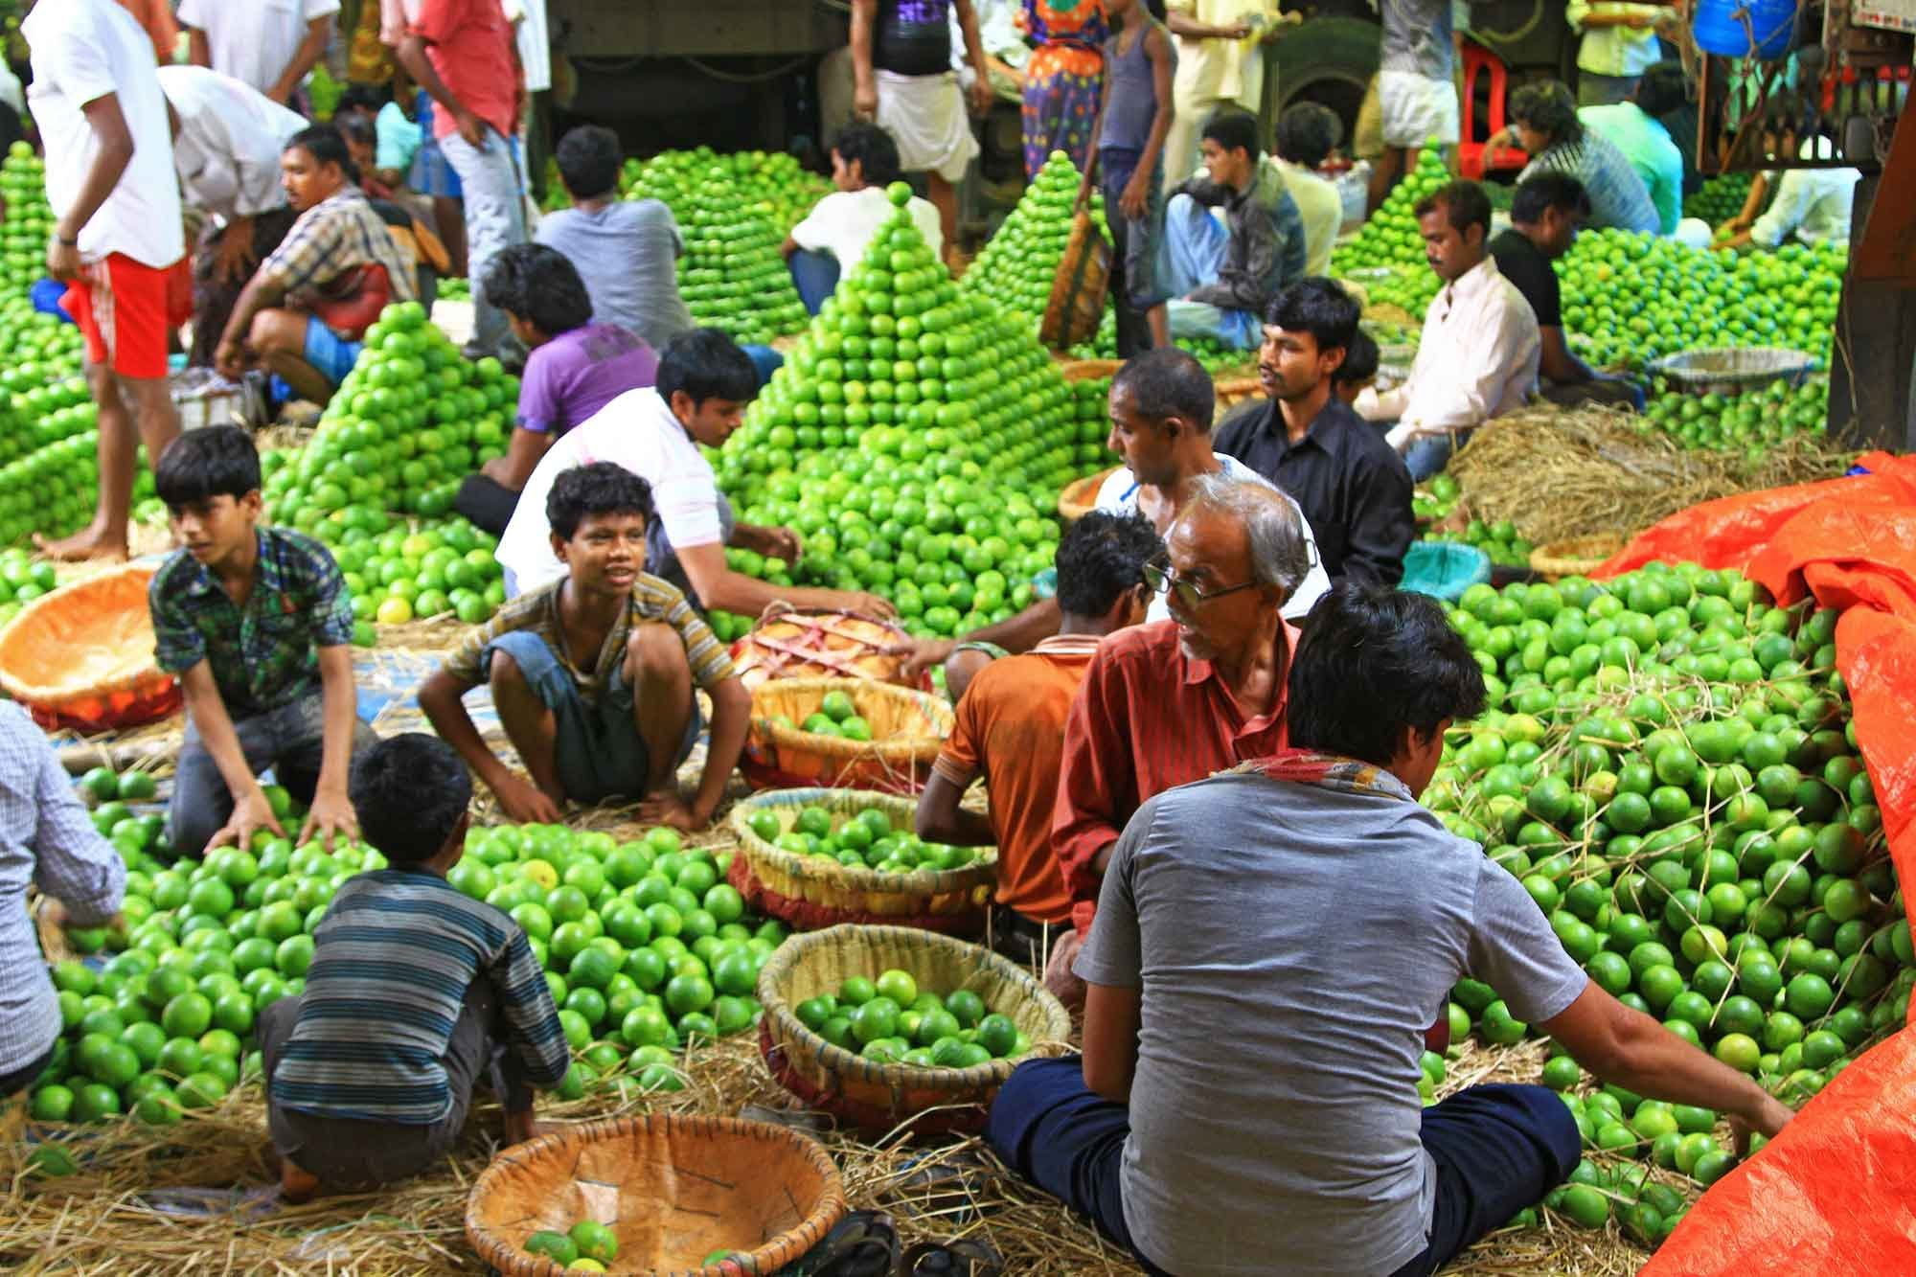
Notes:
INES
What do you see here?
What is a market?
More than a market place where people go to get products……… A market system includes all the supply chain from producers to final consumers as well as many other things and factors that affect them.
use the spiderweb to show it! In the recap of the activity just introduce the idea of actors, infrastructure and environment ….
Warm Up – A Market System – the Spider Web Led by Inés
Objective: to show that markets have many actors and many other things affect them (such as transport, regulations, taxes...), and to show that we need to understand the full market system.
Resources needed: ball of string
Ask the participants to stand in a circle. Then, choose a question, such as ‘what is your favourite morning drink’ (for example ‘coffee’). Hand a ball of string to a participant and ask them to name an actor or influence on the market system (pickers, roasters, traders, buyers, those making cups, transport, government taxes, shipping, regulatory environment, storage facilities....). The first person should keep hold of the end of string, but throws the ball to another participant. Each participant names an actor in the chain and throws the ball of string to another participant. This will then produce a complicated, spider’s web like pattern. The web represents the connections and relationships between and among individuals and groups of people –it is complex. The training will make us understand how to represent this relationship and how to understand these connections.
Circle game
Objective: Introducing the Group
Resources needed: ball
Hold a ball and introduce yourself by name. Throw the ball to someone else and they need to introduce themselves. Continue playing until everyone has introduced themselves. Now, have the ball again and tell people, you have to a) introduce yourself and then b) name the person that you will throw the ball to. If you have time, you can then add on extra criteria, such as a) your own name, b) name of the person you are throwing to, and c) something special about you, or where you work, or your best holiday or........!
A market is:
A market system is a network of producers, suppliers, traders, buyers, and consumers
All are involved in producing, exchanging, and consuming a particular item or service
The system includes various forms of infrastructure, input providers, and services
It operates within the context of the rules and norms that shape this system’s particular business environment

Slide 4
Market system: Definition
A market system is a network of producers, suppliers, traders, buyers, and consumers
All are involved in producing, exchanging, and consuming a particular item or service
The system includes various forms of infrastructure, input providers, and services
It operates within the context of the rules and norms that shape this system’s particular business environment
Notes:
INES

Slide 5
Workshop objectives
To identify through a rapid market analysis the nature of selected market systems to inform contingency planning, preparedness, DRR programming, and linkages to longer term programming;
Strengthen capacity of the CWG members in market analysis and in its use in response analysis and design as well as DRR, preparedness and contingency planning.
Notes:
BEN

Slide 6
Expectations
?
Notes:
What are your expectations in relation with the workshop objectives and outcomes (per table on post its) INES
Do the activity in groups of 2-3
While they are writing, Ben make a flip chart page where they can put the post its
5 minutes
OPTIONAL ADDITIONAL ACTIVITY
What do you want?
Objective: to share participants objectives of the training
Resources needed: post it notes and large sheet of paper (flipchart)
Participants discuss their expectations of the training (e.g. understand tool and apply with confidence, beyond EFSL, other sectors, links to long term, better responses etc) and what they want to use the training for. Elicit this and record. This can then be used as a training plenary, to assess progress.

Slide 7
Workshop learning outcomes
Recognise the importance of market analysis as an essential input to response analysis
Design and carry out baseline market analysis to inform an appropriate response design for any rapid onset emergency in Bangladesh
Be able to apply the analysis to preparedness, contingency planning and project design (CTP and /or in-kind), including DRR
Propose innovative programming combining different types of direct and indirect interventions throughout the project cycle
Identify relevant parameters to be monitored to update baseline information and analysis and to know when to trigger different responses.
Notes:
= why is EMMA/market analysis essential to situation analysis and therefore to response analysis? What does it bring to response analysis? How can it provide additional elements for more innovative and appropriate programming?
Ben
3 minutes

Slide 8
Norms for achieving outcomes
Respect
Participation
Computers closed
Listening to each other
Mobiles silent
Time management
Attendance & punctuality
Constructive feedback
Others?
Notes:
BEN
Rules: what do we need from ourselves, other participants and from facilitators to have a conducive environment for learning and exchange?
3 minutes

Slide 9
Daily Timetable
09:00– 10:30 Session 1
10:30 – 10:45 Break
10:45 – 1:00 Session 2
1:00 – 14:00 Lunch
14:00 – 15:30 Session 3
15:30 – 15:45 Break
15:45 – 17:30 Session 4
Notes:
To be adapted to participant and facilitator preferences.
Make it 8:30 to 5:00 BEN
1 minute

Slide 10
Housekeeping
Exit
Toilets
Breakout areas
Tea and lunch locations
Field trips
Training materials
Notes:
Modify according to location.
BEN
5 minutes

Slide 11
Workshop style, methods, themes
Learning by doing
Activities based on real data and core skills
Preparedness, relief, and recovery
Sudden and slow onset emergencies
Water, sanitation, hygiene, shelter, food security, livelihoods, finance, logistics, and human resources

Slide 12
Agenda
Sunday | Monday | Tuesday | Wednesday | Thursday
Introduction and expectations | Scenario, situation analysis and response intentions | Gap analysis | Data collection | Data collection
Different response options in humanitarian response | Selecting target population and critical markets Key analytical questions | Market analysis | Data collection | Data collection
LUNCH | LUNCH | LUNCH | LUNCH | LUNCH
Continuation... | Baseline mapping | Response analysis and response options: first hypothesis | Data collection | Data collection
Market analysis in humanitarian response | Emergency mapping | Field work preparation | Analysis of data collected during the day | Analysis of data collected during the day
Notes:
To be adapted to suit needs
INES
THIS STILL NEEDS FIXING

Slide 13
Agenda
Saturday | Sunday | Monday | Tuesday
Data collection | Data collection | Presentation of main results | Cont. Analysis by team leaders
 |  | Market and gap analysis
Data collection | Data collection | LUNCH
LUNCH | LUNCH | Response recommendations
Data collection | Data collection | Next steps: contingency planning | Presentation to stakeholders
Analysis of data collected during the day | Finalisation of tools / consolidation of results | Wrap up End of workshop
Notes:
Put this on flip chart paper on wall

Slide 14
This needs to be done in 1 hour
8.30 to 9.30

Slide 15
Day 1 plan
Session | Timing
Opening: Introduction and expectations | 60
Introduction to humanitarian MSA (1) | 30
Coffee break | 15
Introduction to MSA: EMMA and PCCMA Intro (act included) | 60
Introduction to MSA (2) baseline map | 75
LUNCH | 15
Introduction to MSA (3) emergency map | 120
Coffee break | 15
Scenario selection and needs analysis | 75
Notes:
Here it is!
I have squeeze it, so as that we reach end of day one as in the original training and baseline maps are done before lunch as you suggested.
I think that the morning session is very dense and we will need to rush, rush, rush
We might consider to move scenario selection and need analysis to day 2.
And then leave the whole afternoon for the maps…..

Slide 16
Introduction to Humanitarian Market System Analysis 1
Notes:
INES

Slide 17
Session outcomes
By the end of the session, participants will be able to:
Understand that markets are a key institution in people’s lives
Understand why humanitarians need to undertake market analysis
Understand when to undertake market analysis
Notes:
Key Messages – for reference BEN
Markets exist even following disasters
Markets play a vital role in the lives and livelihoods of the people that we work with
Markets are complex and have many different components/ actors/ environments
Understanding markets is more testing to see the relevance of cash transfer programming. Analysing markets will give us the tools to understand:
What markets provide the critical needs of the target population
the capacity of markets to respond to meet needs
a broader range of appropriate responses - whether cash or in kind
Market analysis can be used in a variety of contexts (rapid onset, slow onset), and across all sectors (WASH, food security...)
Market analysis will help to design better and broader response options to meet emergency and early recovery needs and inform a range of programmes – emergency relief, early recovery work, contingency planning, preparedness, DRR programming and link to longer term development work.
We need to assess markets before any intervention (cash or in kind), understand the risks of our responses doing harm to market systems and understand what response options we have.
Lives and livelihoods are supported by a complex web of people, structures, services, and rules. These are all part of the market system.
Markets exist even in emergencies.
Market analysis enables practitioners to understand the functionality, capacity and expandability of specific markets
Market analysis enables practitioners to develop a broader, more appropriate set of responses;
Market assessment facilitates more efficient use of humanitarian resources and encourages transition to economic recovery.
Market analysis can be done at any time, and each organisation needs to be clear as to how they want to use their market analysis.
This training is based on the Emergency Market Mapping and Analysis (EMMA) toolkit

Slide 18
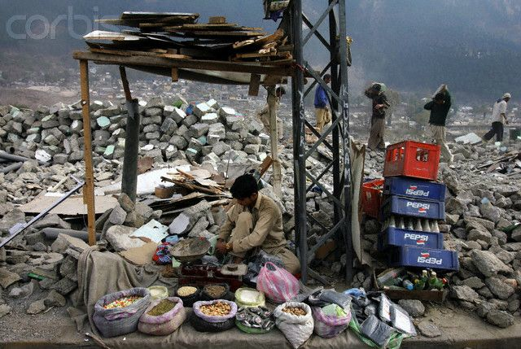
Notes:
Activity - Market in emergencies BEN
Objective: to show that markets do exist, even in emergencies
Resources needed: pictures– these can be found in the bank of photographs found at the end of the ppt.
Show a picture of a market, operating even in the context of an emergency. Elicit answers to questions, such as:
What does this picture tell you? (markets operate even in emergencies) What might have happened?
How might people have been affected? What might they need? (situational needs)
Why are we looking at this? What would you do? What if you distribute in kind? What do you need to decide on response options? What does this mean for our programming? (risks, capacity and responses)
Photo credit: Unknown, downloaded from: www.saagarikaghoshal.com
OPTIONAL ADDITIONAL ACTIVITY
Tell a story
Objective: to share the story of a market baseline
Resources needed: at a minimum –market maps – can be delivered verbally. Can also use pictures to make the work seem more real.
Give a quick overview of a market baseline that you know about. Try to choose a market assessment that led to a broad range of direct and indirect responses (Direct responses: Actions that make direct contact with emergency-affected households. Indirect responses: Actions with others (e.g. traders or officials) to benefit indirectly households affected by the emergency.)
This will include the context, market assessment findings (with maps), and talk through the impact on the market, the recommendation options identified and those used/ implemented etc…

Slide 19
Why assess markets?
Notes:
Why does market analysis matter? INES
Objective: To elicit and share why market analysis is important
Resources needed: slides of market in emergency (emergencies)
Ask for initial ideas – why do we assess markets?
Show the next slide(s) of markets in emergencies.
Recap that markets are central to the majority of the world’s population and that they continue to exist in some form, even in emergencies.
Ask what participants the impact of market analysis would mean on their programmes. Elicit answers.
Indicate the reasons above.
Why to assess markets in “normal times”? Consider to introduce the idea of PCCMA

Slide 20
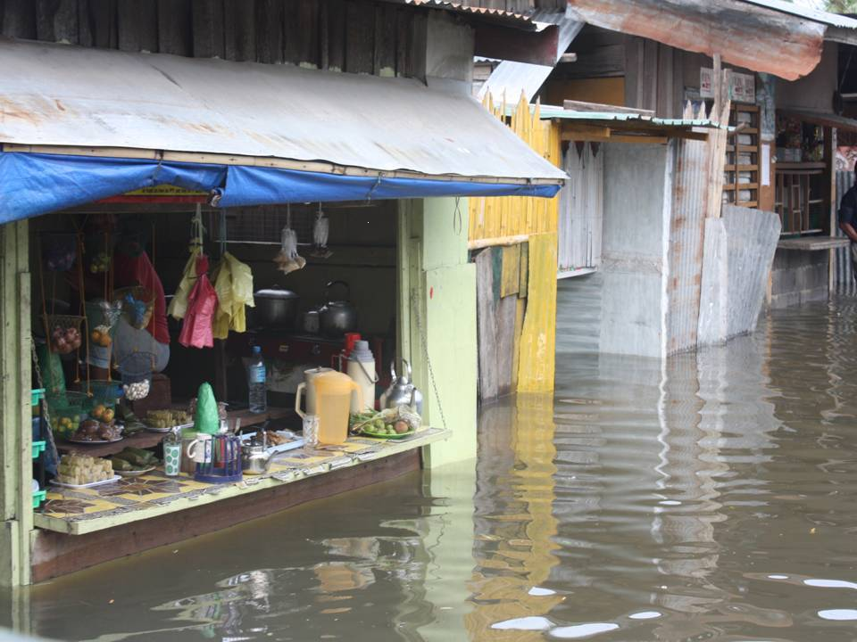
Notes:
Courtesy of CaLP – Cotabato City Flood INES
Before going to the next slide, the setup is to ask the question: “What do markets provide to people in emergencies?” The next slide lists basic answers. Go to that slide after participants have had a chance to provide some of their own suggestions.

Slide 21
Market systems matter in emergencies
Ensuring survival:
Providing essential items or services to meet basic needs
Protecting livelihoods:
Providing tools, agricultural inputs and services, or replacing other livelihood assets
Providing jobs and opportunities for wage labour, or linking to buyers for their produce
Notes:
What do markets provide to people in emergencies?
INES

Slide 22
Why carry out a market analysis?
Refine decision making for programme design (response analysis):
  choice between transfer modalities (cash, in-kind):
  Support target groups’ access to their basic needs and services (purchasing power, availability, conditions of access)
  Identification of complementary ‘indirect’ actions (support to markets), with multiplier effects, to help markets recover and meet people’s needs
  = Consider broader, more innovative range of responses for higher impact
Notes:
BEN Part of the choose between transfer modalities is to determine market capacity to meet demand and needs, anticipate risk and potential impact of different modalities on different parts of market chains and people’s livelihoods
We can support access to basic needs and services by understanding the links between target groups to critical markets. We can compare how markets function normally (baseline) and how they have been (or are predicted to be) impacted by crisis;

Slide 23
Why carry out a market analysis? (2)
We can then develop responses with:
Higher cost efficiency
Improved effectiveness and impact (people’s preference & markets capabilities)
Reduced risk of doing harm to market systems and therefore to people’s livelihood and access to markets
Connectedness with economic recovery
Re-establishing markets around people
            AND:
For relief / survival, livelihoods recovery, protection and promotion, preparedness and DRR
Provide rationale for communication & advocacy
Notes:
NOTES BEN
Higher cost efficiency - (use of existing market capacity => better use of humanitarian resources – not reinventing the wheel, but working through what is there) Cost efficiency: get the same output for less
Effectiveness: get more expected results, ie more adapted to people’s needs and situation
Connectedness to early recovery - – understanding how humanitarian responses can tie in and support market and livelihood strengthening.
So, we carry our market assessments, to enable the development of better response options

Slide 24
When to carry out a market analysis?
Notes:
INES
When is market analysis appropriate?
Objective: to establish when to do a market analysis
Draw a picture of a shock in the middle of a flipchart. This could be resented as a large star explosion:
Draw a timeline either side of the shock. Ask participants to come and put a mark when they think market analysis could/should be done. Point out that market analysis can be done at any time - from preparedness, to contingency planning, DRR, mitigation, emergency response, early recovery and long term development. Show slide of workshop focus
The exact process and timing of a market analysis will depend on the specific objective of your agency in undertaking it (emergency response, contingency planning, preparedness etc), as well as the original intentions that each agency has in the form and extent of response implementation.
As humanitarians, we need to be clear what our role is, and how we can work together with other colleagues to ensure better transitions between humanitarian and development programming.
Humanitarian market analysis tends to be done either as
part of a needs analysis in an emergency (mapping market in crisis and investigating through interviews, data etc, how it operated PRE-crises)
OR
as a market baseline for preparedness, mapping the ‘normal’ picture of a market system, then forecasting the impact of a crises.

Slide 25
Workshop focus
Mitigation and early ‘no regret’ activities
Humanitarian Response and Early Recovery
Sustainable Development
Preparedness
Disaster
Notes:
25
25
INES The workshop focus will be in the highlighted green area.
Emphasise that activities before and after an emergency should be complementary and with the overall aim of helping people to live independent, autonomous lives.
CTP provides a link between ‘life saving’ activities immediately after a disaster, and recovery activities, contributing to rebuilding infrastructure and livelihoods, and building on people’s capacities leading to sustainable development activities. This link is sometimes known as early recovery. Preparedness is essential when dealing in multi-sector response: agreeing modality, feasibility, etc in advance of the emergency is vital.
The separation of relief and recovery from sustainable development activities is not always satisfying to participants. All are important, but the bias here is partly the result of CaLP and ECHO mandates focusing on relief and recovery.
We need to be clear about the objective of our market analysis (and what you intend/want to do with the findings)– as this will affect HOW you use the findings, in terms of timing, monitoring, range of responses and implementation. EG in preparedness – you may be able to design and implement reposes that could mitigate the effects of a predicted shock.
We need to remember that we are humanitarians. This means that we may not have the time and capacity to implement long term development planning. We should, however, think about how our work could better transition into the long terms work that is planned or ongoing and look to see how our responses can be tied in or support longer term livelihoods.
Link with PCMMA as it comes after the break

Slide 26
Coffee break at 10.00
Consider to remove slides

Slide 27

Notes:
BEN
2 agencies leading the EMMA work: IRC and OGB
EMMA started in 2006 – 2007 after the learning of the tsunami, process started with a desk-based review, 4 pilots and final toolkit was published at the beginning of 2010, more than 20 EMMA assessments have been carried out by different agencies since its development
Developed for non market specialists, the EMMA toolkit was designed1 to be used in sudden onset crises and has the concept of rapid and realistic, ‘good enough’ analysis at its core.
Market analysis can suit different contexts (rapid onset, slow onset, preparedness, contingency planning), but note: we are still thinking of analysis from a humanitarian point of view - rapid and ‘good enough’ analysis.

Slide 28
The EMMA Approach
Flexible, adaptable, built on logical steps
Based on rough and ready, speed-oriented tools:
  “Optimal ignorance”
  “Appropriate imprecision”
Iterative: revise, refine, “good enough” analysis
Requires selection of critical market systems
Based on creation, use of market maps: visual and intuitive
Relies on good needs and context analysis
Notes:
Consider to name this one approach instead of process?
Is flexible and adaptable, built around a series of logical steps BEN
The 10 steps of EMMA page 14 and 15 (iterative process)
Considers the wider market system, not just the market place and affected community; markets not only what people depend upon (economic recovery), but also because in short-term they may be best way to get humanitarian aid to people (emergency response)
Based on creation and use of market maps that are visual and intuitive market mapping is at the heart of EMMA, and its main tool
Requires selection of the market systems most critical from an humanitarian perspective; i.e. that one which the agency believes will most effectively help to recover the target group’s lives and livelihoods
Works both for market systems that supply goods and services, and for those that are a source of income to emergency-affected populations
Recognises that markets are vital in short term emergency response (if they are functioning sufficiently) and in the long term for economic recovery, livelihood protection and promotion.

Slide 29
The 3 strands of EMMA
Gap:
People, priority needs and preferences of most affected
Market:
Market system, constraints and capabilities
Response:
Emergency response, different options and opportunities
Markets
Gaps
Responses
Response Options
and
Recommendations
Notes:
Introduce EMMA toolkit and approach INES
Objective: To give BRIEF overview of the development, and process of an EMMA
Resources needed: EMMA books
Highlight 3 strands of EMMA – gap analysis (understanding the priority needs of the target population), market analysis (understanding each critical market system in terms of its constraints and capabilities to play a role in the emergency response), response analysis (exploring different possible responses).
This training will follow this same logic – needs, market analysis, response analysis.
Look at the EMMA principles (pg 16) – highlight:
that EMMA is speed oriented – using depths of analysis essential for programming and pragmatic within time. This means dealing with optimal ignorance and appropriate imprecision.
Is iterative
Does not put markets before people
Uses other assessments – (household surveys, trader interviews)
Look at the 10 steps of EMMA (pages 14-15)
Discuss flexibility – how can I use this for my context? For my sector?

Slide 30
EMMA’s core logic
Baseline: How was the market system functioning before the emergency?
Emergency: How has the market system been affected by the emergency? How does it function now? What are the major constraints affecting the market? How can they be mitigated?
Expandability: What is the expandability of the market capacity? How could it be reached?
Capacity of market to cover HH gap: Can market meet the current needs? And under which conditions?
Notes:
30
What would you look at to know if markets can respond to the gap?
Put figures to the map, make it dynamic (start characterising the arrows and giving them a meaning beyond the link => how is that link? / give a meaning to that box: how that this actor functions, what are his capacities and constraints, how does it relate to the environment and …), look at performances, capacities and capabilities
In order to know if the market can respond we need to look at 3 aspects => EMMA’s Core logic is summarized in 3 sets of questions
Also consider seasonality and phasing

Slide 31
EMMA’s core logic
Past
Baseline
Present
Impact
Future
Forecast
Capacity of market to cover HH gap: Can market meet the current needs? And under which conditions?
Notes:
INES
Future forecasting – previous data from disasters, seasonality big element, six month programmes (for e.g.) then revisit analysis for longer term programming
Can start an EMMA as soon as the dust settles (e.g. Haiti 2010 – 2 weeks after (quick one, then full on EMMA), Philippines almost immediately) but need to revisit information
Baseline: How was the market system functioning before the emergency?
Emergency: How has the market system been affected by the emergency? How does it function now? What are the major constraints affecting the market? How can they be mitigated?
Expandability: What is the expandability of the market capacity? How could it be reached?

Slide 32
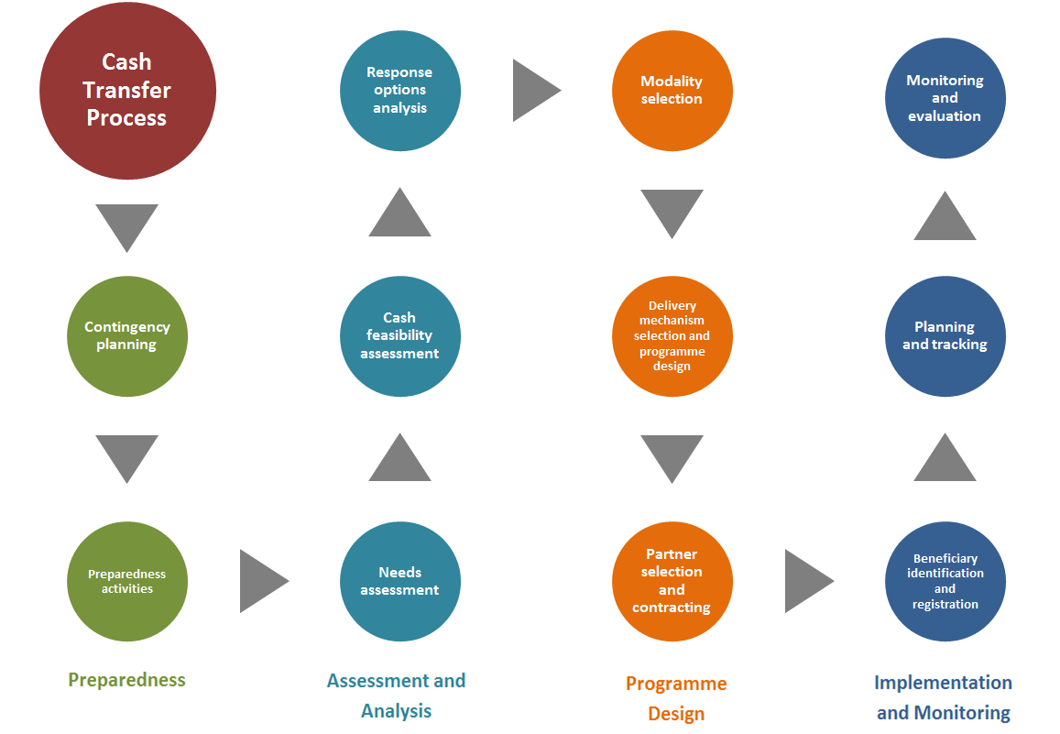

Market assessment
Market assessment
Notes:
BEN
THIS ONE CAN BRIDGE EMMA AND PCCMA.
WE NEED TO ADD THE MARKET ASSESSMENT OVAL IN THE PREPAREDNESS COLUMN AS WELL AND SHOW IT AFTER THE ASSESSMENT AND ANALISYS
VERY HELPFUL TO UNDERSTAND THE DIFFERENCE AMONG BOTH AND WHERE PCCMA COMES FROM
Ask what information might be needed before doing a market assessment (elicit context and needs analysis). Show CaLP slide indicating when in process market analysis should be done (animated on slide)
Highlight that market analysis is based on good grounding of needs and context analysis.
OPTIONAL ACTIVITY
Highlight that the logic of YOUR training programme (could begin in a number of ways – refer to overview notes). For example...
Objective of market analysis (in this case contingency planning and preparedness)
Scenario selection
Selecting scenario
Selecting target groups
Needs assessment
Gap analysis
Market assessment
Market functionality and expandability
Can the market cover the needs gap?
Response option design
Response selection
Implementation
Monitoring.
Write these out on cards and then display - to act as a reminder to participants and to support understanding of the process

Slide 33
Pre-crisis assessment objectives
Market Baseline Analysis
Build capacity
Baseline Reference Point
Improve preparedness
Feed into Contingency Planning
Mitigate Impact of a Crisis
Build Resilience of Target Group
Notes:
BEN talks about the Slide and Ines leads the activity.
Build staff/ partners capacity in market analysis and change approaches and attitudes to market based programming.
Provide a baseline picture of how critical markets function when they are not under stress – to compare with post shock map
Improve the preparedness of agencies to respond to impending or evolving crises by comparing a baseline ‘less stressed’ market map with a forecasted stressed emergency map. This process helps predict the level of need of the target population and analyses the degree to which the market can respond to these needs. Appropriate responses can then be designed and prepared which promotes timely and effective assistance.
Support contingency planning exercises. As with improving preparedness to respond, market analysis supports the contingency planning process, by offering a realistic picture of likely effects of the crisis and recommending responses that address these.
Mitigate the impact of a crisis. Pre-crisis market analysis will identify which areas of the markets may be deeply affected in a crisis, or those areas that need strengthening to be able to operate for the benefit of the target group. Immediate interventions can be designed that reinforce certain parts of the market system, helping to mitigate the effects of the crisis.
Help build resilience. Many markets that operate in ‘normal’ times are actually quite weak, dysfunctional.
Understanding the dynamics of market systems can help agencies design interventions that improve longer term access to basic needs and strengthen livelihoods. This will help to build the resilience of the targeted vulnerable populations to predicted or evolving shocks and can begin to address the long term, or ‘chronic’ nature of vulnerability and poverty in some areas.

Slide 34
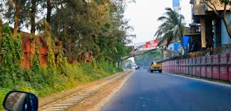
Pre-crisis assessment process
Notes:
Activity Lead by INES
exercise: (groups of 5 people) we give to each group big cards with different steps on each card (one card = one step) and give them 10 or 15 mins to put in order and stick them in the wall.
c) Phase two of the exercise, we give them key activities of different steps and they need to put them under the correct step.
d) Then they look at the other groups classification and if they don’t agree put a red sticker (I have this with me)
Quick feed-back in plenary just to check that it is clear what the steps are and key activities in each one
20 MINS

Slide 35
NEEDS TO BE DONE BY 11.15

Slide 36
Introduction to Humanitarian Market System Analysis 2
Notes:
BEN
Key Information – for reference
There are three sections to the market map
The market chain
This is the complex web of different market actors who buy and sell the product as it moves from primary producers / suppliers to the final consumers / buyers. These actors include, for example, small-holder farmers, larger-scale producers, traders, processors, transporters, wholesalers, retailers, and of course consumers.
Key infrastructure and support services
The map also includes various types of critical infrastructure, inputs, and services that are provided by other service enterprises, organizations, and governments. These actors and services are those which support the market system’s overall functioning or performance, even though they do not directly buy or sell the item. For example: transport, financial services, farm inputs, storage.
The market environment
Importantly, there are other factors that strongly influence how producers, traders, consumers, and other market actors operate in the emergency situation. These factors include formal policies, regulations, and rules; informal social norms – such as gender roles, official and business practices; trends and current affairs – including patterns of social and political conflict, and economic and environmental trends.
Market analysis seeks to understand what the blockages, capacity and expandability of the market system is to meet the needs of the target group. This will help design better response options.
The need of the target group is the starting point for the analysis. All interventions should be FOR your target group. This does not mean that all interventions will be directed AT your target group. Sometimes, enabling better access of your target group to a particular good or service will mean addressing blockages further up the market chain. (For example, a lack of storage facilities for middle sized traders in the fish market system may mean high or even prohibitive prices for target group, as fish are not caught so plentifully). In this sense, helping to develop better storage system, might ensure a more affordable and available source of food.

Slide 37
Session outcomes
By the end of the session, participants will be able to:
Create a basic baseline market map and describe its function
Differentiate between markets and market systems
Understand that the needs of the target group is the starting point for analysis
Notes:
BEN
The need of the target group is the starting point for the analysis. All interventions should be FOR your target group. This does not mean that all interventions will be directed AT your target group. Sometimes, enabling better access of your target group to a particular good or service will mean addressing blockages further up the market chain. (For example, a lack of storage facilities for middle sized traders in the fish market system may mean high or even prohibitive prices for target group, as fish are not caught so plentifully). In this sense, helping to develop better storage system, might ensure a more affordable and available source of food.

Slide 38
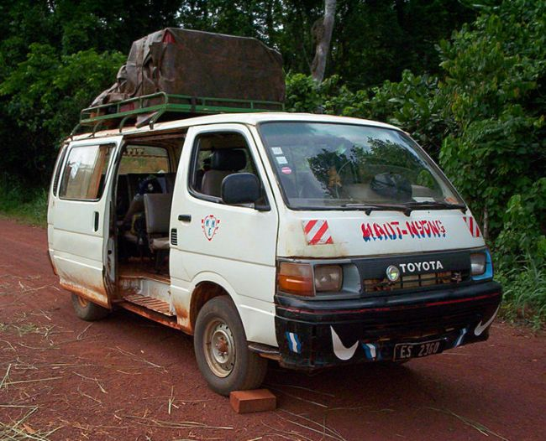
Notes:
BEN
The Taxi Map 1- Objective: This exercise is primarily designed to demonstrate market mapping,
Resources needed: pictures of taxis, slides of market baseline and emergency map for taxis, flipchart paper, different coloured marker pens
Use the taxi slides to illustrate the range of taxi markets in the world. Make the point that taxis especially in poorer countries are the only source of transport for the rural and urban poor, needed to support their lives and livelihoods. Remind participants that we need to keep the needs of our target group as the motivation behind all responses, but this does not mean that all responses directly involve them.
Tell participants that they are going to imagine that the taxi driver and they (the service users), are the people at the centre of the story.
Ask: “What does the taxi driver who provides the service need to make his business work?
Take responses from the group (hopefully they will suggest things like petrol/gas, a car/vehicle, roads etc).
Where does the vehicle come from, who else depends on it? Who uses it? (Customers, operator/driver, vehicle owner, vehicle leasing, importer etc – bringing out the MARKET CHAIN);
Over the next few slides, elicit more answers.

Slide 39

Notes:
BEN
What is it? What do you see? What are they doing?
Where do they come from?
What is required for manufacturers?
What do they need to operate?
What does the vehicle and its operator need to operate effectively? How are they built? What are the manufacturing requirements? (Roads, mechanic services, filling stations, training etc – bringing out the INFRASTRUCTURE, SERVICES, INPUTS);

Slide 40
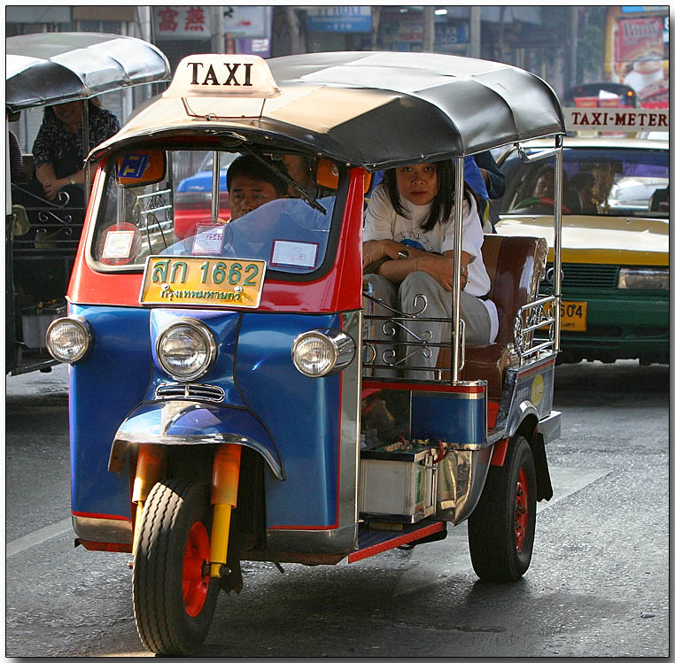
Notes:
BEN
Which ones do you have here?
Do we see taxis like this in….London, New York etc. Why? (rules and regulations)
Can anyone drive a car? A taxi?
What laws, rules etc govern the use of the vehicle? This will help to elicit (Licensing, public transport policy, road laws, taxi driver union dues etc – bringing out INSTITUTIONS, RULES, NORM, TRENDS etc).

Slide 41
The taxi vehicle market
  Market chain
  Where does the vehicle come from; who else is concerned with it?
  Infrastructure, services, inputs
  What does the vehicle and its operator need to operate effectively?
  Institutions, rules, norms, trends
  What laws, rules, etc. govern the use of the vehicle?
Notes:
BEN
All the actors and aspects that we have talked about can be summarized in three groups – go through features of each (above)

Slide 42
Mapping the taxi vehicle market
Your groups represent “TaxiHelp”, an aid NGO that supports the livelihoods of the urban poor through interventions aimed at local public taxi services;
Draw a map of the taxi vehicle market system: all the market actors that enable the vehicle to be operated effectively, providing support for the urban poor users;
Show all the actors in that system, and any links between them;
Think about the market chain, the infrastructure, and the rules, institutions etc. that affect the market;
No ‘right answer’, just start and make a basic map;
Make any appropriate assumptions.
Notes:
BEN
All the actors and aspects that we have talked about can be summarized in three groups
The Taxi Map - Activity
Resources needed: pictures of taxis, slides of market baseline and emergency map for taxis, flipchart paper, different coloured marker pens
Explain that in each of their groups – they need to imagine that they each work for TAXIHELP, an aid NGO that supports the lives and livelihoods of the urban poor, by supporting effective local public taxi services.
In groups – participants now have about 20-30 minutes to draw a map of the taxi vehicle market system, showing:
In plenary, ask for feedback.
How did you find the exercise? Why did we choose the taxi market, rather than just ‘transport? Why is it important to be specific about the choice of critical market system? Was it difficult to transcribe your ideas about the market system and how it all connects? Does it help to communicate a complex situation?
Compare maps between groups.
Would you have been able to understand each others map without explanation? Did you put a legend? What makes it clear? What do you think of the different maps? Do you have missing information? Who would you talk to find the missing information?
Have them draw the baseline maps and then break for lunch: when return from lunch do gallery walk and analysis of maps (remaining slides in module)

Slide 43
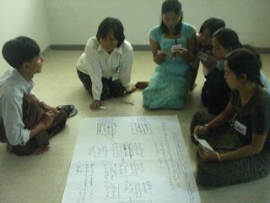
Mapping: just start!
Notes:
ben

Slide 44
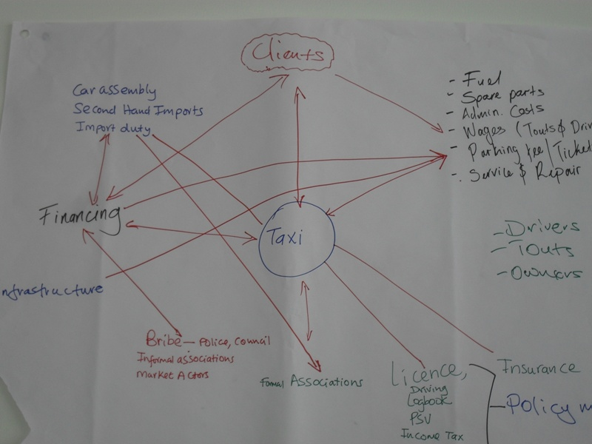
Notes:
Ben
Examples from other teams in other workshops: to show that there is not one only way to draw a market map

Slide 45
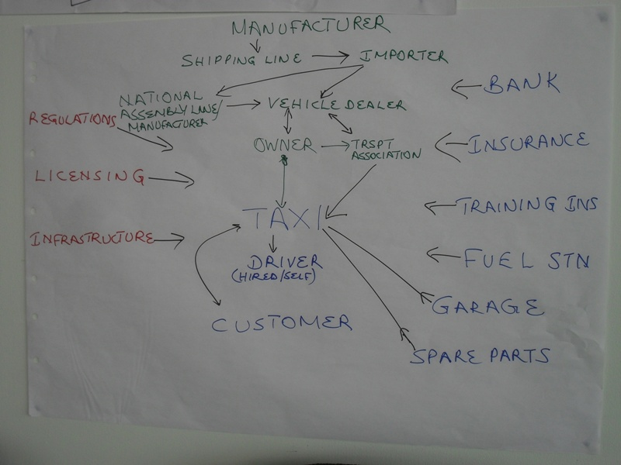

Slide 46
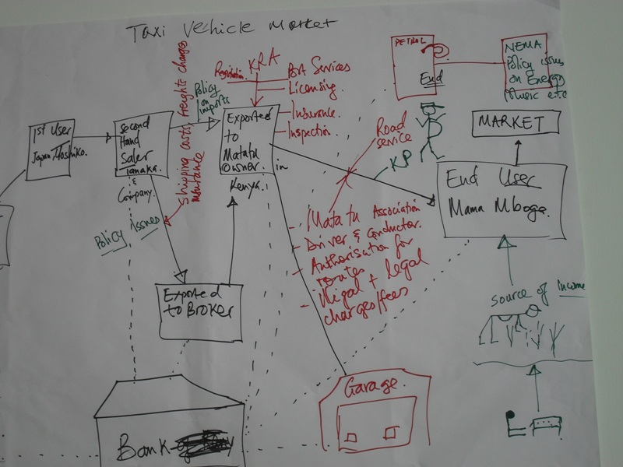

Slide 47
Market system for taxi vehicles
The Market Environment: Institutions, Rules,
Norms & Trends
Financial Regulations
Taxi License System
Traffic
Regs. & Policing
Public Transport Policy
Import Tariffs
Leasing Laws
Taxi Drivers’ Union
Company Expenses Policy
The Market Chain:
Market Actors & Their Linkages
Taxi
Owner
Business Customers
Vehicle Importer
Taxi Operator
Vehicle Leasing Co.
Urban Poor Users
Key Infrastructure
& Market Support
Services
Insurance
Services
Roads & Bridges
Garage Mechanics
Financial
Services
Driver Training
Cash ATMs
Filling Stations
Notes:
BEN
1. Share the EMMA style taxi baseline map. Ask participants to look at the way the map has been done. Ask participants how they can ‘read’ this map. What does it tell you? Highlight standard maps start with largest manufacturers (to the left) and tend to have the target group on the right. Highlight the key infrastructure and market environment
2. Highlight that there are three sections to the market map
The market chain
This is the complex web of different market actors who buy and sell the product as it moves from primary producers / suppliers to the final consumers / buyers. These actors include, for example, small-holder farmers, larger-scale producers, traders, processors, transporters, wholesalers, retailers, and of course consumers.
Key infrastructure and support services
The map also includes various types of critical infrastructure, inputs, and services that are provided by other service enterprises, organizations, and governments. These actors and services are those which support the market system’s overall functioning or performance, even though they do not directly buy or sell the item. For example: transport, financial services, farm inputs, storage.
The market environment
Importantly, there are other factors that strongly influence how producers, traders, consumers, and other market actors operate in the emergency situation. These factors include formal policies, regulations, and rules; informal social norms – such as gender roles, official and business practices; trends and current affairs – including patterns of social and political conflict, and economic and environmental trends.
Highlight that the map always seeks to analyse the market system for the target group (here urban poor users).

Slide 48
Key Messages
Lives and livelihoods are supported by a complex web of people, structures, services, and rules.
Based on the EMMA, market analysis revolves around the core concept of the ‘market system’.
A market system is a network of producers, suppliers, traders, buyers, and consumers.
All are involved in producing, exchanging, and consuming a particular item or service.
The system includes various forms of infrastructure, input providers, and services.
It operates within the context of the rules and norms that shape this system’s particular business environment
Notes:
ben

Slide 49
Key Messages
Market maps are a powerful way to:
collate and represent information about market systems;
facilitate discussion, interpretation, and analysis of data within the EMMA team;
communicate findings about market systems to others.

Slide 50
Key Messages
  There are many ways to communicate how markets systems work.
  However, as a communication tool, it is vital that we have a shared way of presenting this, so that everyone can understand what we are trying to say.
  Including ALL actors in a market system might make the maps confusing and incomprehensible as a tool. We need to think about and decide what the critical information is.
Notes:
BEN

Slide 51
12.30 Lunch time
75 mins allocated to baseline map

Slide 52
Introduction to Humanitarian Market System Analysis 3
Notes:
INES

Slide 53
Session outcomes
By the end of the session, participants will be able to:
Differentiate between direct and indirect response modalities
Create a basic emergency market map and describe its function
Compare the baseline and emergency maps to create a list of potential responses
Understand that market analysis is an essential part of situational analysis and response design.
Notes:
INES
Lives and livelihoods are supported by a complex web of people, structures, services, and rules.
Emergencies can have an impact on all aspects of the market system. Emergency market maps can enable agencies to:
Understand how critical markets function
Understand what blockages there are in the system, that need to be addressed for the market to be able to meet the target groups’ needs.
Understand that, whatever the response, the ultimate beneficiary should be the target group (through easing blockages in the market system)
Understand that there are a range of interventions that is broader than just a question of using cash or in-kind
Understand that direct and indirect responses can be appropriate to support the target group to meet their critical needs.

Slide 54
Notes:
INES
Back to the taxi market map => we did the baseline one, now we will do the emergency one
Remind participants about the baseline market maps that they made for the taxi market system.
The Taxi Map – shock!
Objective: This is an exercise to demonstrate mapping, not to explore an humanitarian emergency;
Resources needed: flipcharts of the groups’ maps,
Remind participants about the baseline market maps that they made for the taxi market system.
There has been a shock. Introduce the new scenario (NEXT SLIDE)

Slide 55
Mapping the taxi vehicle market
In the last few days, there have been very few taxis at all in the locality. A serious conflict and riot situation has left much of the city fleet damaged or destroyed.
Some roads are blocked completely, others partially impassable, by riot barricades and general obstructions.
Some gas/petrol stations have been affected and have either run out of supplies or are rationing them.
Insurers have withdrawn their cover to taxi drivers and interrupted them to some of the taxi vehicle leasing companies.
Similarly, financial services to both the leasing companies and vehicle importers are interrupted.
Almost all urban poor domestic customers are ignored in favour of the established business customers who continue to use what few taxis there are.
Local government officials are also starting to impose new rules on the movement of transport in the locality.
Notes:
BEN
The Taxi Map – shock! Introduce the new scenario.

Slide 56
Mapping the taxi vehicle market
Your task (20 minutes)
Please prepare your map and notes that will answer the following questions:
Represent this changed situation on your map. Use the same map.
What other information do you need? How will you gather it, and who will you ask?
Notes:
BEN
In the same groups as for the previous exercise, set the groups their new task. This should take about 20 minutes.
Tell the groups that they are able to make assumptions (as to the cause, how widespread and likelihood of ending) for the context (what caused the riots? Or were the riots the cause?) Sit analysis..?
Read through the emergency situation
Represent this changed situation on the same map.
What other information do you need? How will you gather it, and who will you ask?

Slide 57
Market system for taxi vehicles
Symbol Key
Critical issue
Major disruption
Partial disruption
!
The Market Environment: Institutions, Rules,
Norms & Trends
Financial Regulations
Taxi License System
Traffic
Regs. & Policing
Public Transport Policy
Import Tariffs
Leasing Laws
Taxi Drivers’ Union
Company Expenses Policy
The Market Chain:
Market Actors & Their Linkages
Taxi
Owner
Business Customers
Vehicle Importer
Taxi Driver
Vehicle Leasing Co.
Urban Poor Users
Key Infrastructure
& Market Support
Services
Insurance
Services
Roads & Bridges
Garage Mechanics
Cash ATMs
Financial
Services
Driver Training
Filling Stations
Notes:
BEN
Show the emergency map to demonstrate how disruptions can be shown on the map.
Bring out that:
• a variety of symbols can be used to denote disruption/damage etc;
• maps are used because they provide systematic, structured approach,
• maps are useful tool for communication; and they….
• allow the consideration of only that information that is relevant to the target beneficiary Group.
Highlight that some of the blockages effect the target group INDIRECTLY and so might need INDIRECT responses – try to elicit and example

Slide 58
Response options
Direct responses:
Indirect responses:
Cash or voucher transfers
In-kind transfers (Food or NFI, water, sanitation, shelter, nutrition programmes)
Rehabilitating key infrastructure
Grants or loans for businesses to restore stocks, rehabilitate premises, vehicles, etc
Technical expertise to businesses, employers, or service providers
Notes:
BEN
What type of actions can we design?
Ask participants for the difference between direct and indirect responses. Go through slide and then reiterate difference between response options below.....
Direct responses:
Actions that make direct contact with emergency-affected households
Indirect responses:
Actions with others (e.g. traders or officials) to benefit indirectly households affected by the emergency.
Market analysis will help refine decision making about programme design. This will include the identification of complementary ‘indirect’ actions (support to markets), with multiplier effects, to help markets recover and meet people’s needs. This means it is possible to consider broader, more innovative responses for higher impact.
The breadth of response will be determined, in part, by timeframes, organisational mandates and priorities, response intentions and capacity. Responses can be designed from the moment the analysis has been completed. These responses can connect with longer term work. Strengthening markets to deliver relief can be extended to strengthening markets to support livelihood protection and promotion, thereby helping to build resilience.
Ask participants for examples in their work - Elicit experiences.
Discuss the responses from the shorter term (emergency) to the longer term (market support).

Slide 59
Breadth of Response
Market Based Programming
Market Indifferent
Market Integrated Relief
Indirect Support through Markets
Market Strengthening and Development
Objective: meeting basic needs (food security, etc.)
Objective: meet basic needs through temporary interventions that restore markets
Objective: economic recovery, improvement in incomes and livelihoods
Activities:
In kind distributions
Local and regional food purchase
Cash and vouchers
Seed fairs
Activities:
Targeted support to market actors (grants, loans, transport subsidies, temporary storage)
Support to supply
Activities:
Support to productive and sustainable agriculture
Employment creation
financial services
Supply and value chains
Productive assets
Enterprise development
Notes:
BEN

Slide 60
Mapping the taxi vehicle market
Your task (20 minutes)
Please prepare your map and notes that will answer the following questions:
Represent this changed situation on your map. Use the same map.
What other information do you need? How will you gather it, and who will you ask?
- - - - - - - - - - - - - - - - - - - - - - - - - - - - - - - - - - - - - - - - - - - - -
Once you’ve gathered sufficient information and data, what sort of responses might your agency consider and make to the vehicle market to support the urban poor taxi users and their families to resume their lives and livelihoods?
Notes:
INES
In the same groups as for the previous exercise, set the groups their new task. This should take about 20 minutes.
Tell the groups that they are able to make assumptions (as to the cause, how widespread and likelihood of ending) for the context (what caused the riots? Or were the riots the cause?) Sit analysis..?
Read through the emergency situation
Represent this changed situation on the same map.
What other information do you need? How will you gather it, and who will you ask?

Slide 61
CONSIDER TO DO EMERGENCY MAPPING FIRST WITH POTENTIAL RESPONSE AND THEN PUT THE THEORY AROUND POTENTIAL RESPONSES AND ASK THEM TO REVISIT THEIR POTENTIAL RESPONSE OPTIONS ¿?¿?¿
Introduce that with PCCMA we work with scenarios not evaluating the real impact of a disaster

Slide 62
What kind of responses?
Direct responses:
Indirect responses:
Notes:
BEN
Activity 2 – Taxi Responses
Discuss in groups a range of indirect and direct responses. Stress that although some responses might not directly affect the target group – they will benefit indirectly. If needs be, model a few ideas from the emergency map.
Gather ideas and collect in a table as on the slide
Indicate the range over time of the response options – of short term to longer term. Highlight that re-establishing market functionality is not just short term option, but has clear link to market strengthening.
You might want to list responses in short term to long term, by using post it notes on a wall, by printing out the workshop focus slide and annotating this in groups, or by recording on a flipchart. What is key is that participants know that there are a range of options (direct/indirect) and (shorter term to longer term) that might be appropriate.
The extent that your agency engages with markets will be a result of the mandate, timeframe and objectives. Participants will need to have an idea about their organisations response intentions. This will help select the type of market, the type of market, the extent of needs met, as well as affect the type of response.
Additional Resources
EMMA toolkit –http://emma-toolkit.org/about-emma/faq/
Pictures of taxis and taxi maps – use bank of resources and slides
Slide of WFP-OGB work

Slide 63
2
Notes:
Day 2

Slide 64
Shock Scenario Selection and Needs Analysis

Slide 65
Session outcomes
By the end of the session, participants will be able to:
Clearly identify target group of the market analysis
Understand the scenario selected and the needs identified to meet the needs of the specified target group.
Notes:
BEN
Key Messages - This information needs to be prepared prior to the start of the market analysis workshop.
This step clarifies what the assessment is aiming to inform: what context & type of crisis, what response and what information gaps / needs.
For the market assessment to be as useful as possible, preparation is ESSENTIAL. Moreover, the host/organiser/team leader of the market baseline assessment will need to understand the context, organisational mandate, role and programme intentions, and have buy-in from senior managers.
The information required will clearly depend on what the objective of the market assessment is. We are here assuming that we are looking at building preparedness and developing a contingency plan.
This session aims to establish the following.
Shock scenario (contingency plan): flooding and waterlogging
Target group(s) and differentiated needs (gender, social groups, age) males and females, farmers and most affected households, with focus on most vulnerable.
Needs that the response will address (chronic, emergency) Emergency
Response Intentions - Objectives of the response and expected results, areas targeted, time period of interventions, etc
Responses considered focus on cash transfer programming, direct cash and indirect (market support)
Information needed to decide on the response modalities: mobile money viability, restocking times, livelihood strategies of the households, needs at the HH level, needs at the market level …other?
This corresponds to the Step 1 of the EMMA process: setting the frame and gathering first understanding on people’s needs and situation & context; this is a summary of the needs assessments & response intentions.
December 11 is a day off from the training, and there will be fieldwork done in Sirajganj and Dhaka (Korail) on December 12th and 13th.

Slide 66
Situation analysis
Shock scenario (contingency plan)
Target group(s)
Needs that the response will address
Objectives of the response
Responses considered
Information needed to decide on the response modalities
Notes:
BEN
Presentation of the shock scenario / emergency scenario for assessment. (SEE FACILITATORS PACK FOR BREAKDOWN OF SCENARIO PRESENTATION)
Critical Markets to be studied: potable water and leafy vegetables
be fieldwork done in Sirajganj and Dhaka (Korail)
Objective of the assessment: understand the critical market systems to inform contingency planning and DRR, so that effects of future shock can be mitigated and response executed more quickly and effectively
Scenario: Flooding or waterlogging
Target Group
Needs and Response intentions
POST PRESENTATION - ask
What are the main needs identified?
Which ones will you answer to?
What will be the objective of your project?
What are the probable modalities that you might implement
What information do you need to clarify the modalities? Do you need a market assessment to chose amongst the modalities?
In plenary, take questions from participants, and refine presentation – so the objective of the assessment, scenario, target group, needs and response intentions, are clear and recorded. This will form part of an evolving chart that will remind participants about WHY we do market assessment and HOW we have reached the conclusions and stages we have reached.
This step clarifies what the assessment is aiming to inform: what context & type of crisis, what response and what information gaps / needs.
This corresponds to the Step 1 of the EMMA process: setting the frame and gathering first understanding on people’s needs and situation & context; this is a summary of the needs assessments & response intentions.
This information needs to be prepared prior to the start of the market analysis workshop

Slide 67
Critical Markets Selection
Notes:
Beginning of Day 2
Review of Day 1:
Timing: Review and all slides up to first activity: 45 minutes
First activity: 30 minutes plus gallary walk: 45 minutes
Break

Slide 68
Session outcomes
By the end of the session, participants will be able to:
Understand what critical market systems are
Understand that critical markets are specific to different people, so must focus on target group
Apply the essential criteria used to select critical market systems to be assessed in the baseline
Notes:
Key Information – for reference BEN
To select critical markets, you need to sure of the scenario, what responses you are aiming to support and what are the specific needs for the selected target group.
The choice of critical markets will vary for different people/livelihood groups.
Every crop, non-food item, or service has its own particular market system. This means that it is necessary to decide pragmatically which market systems - i.e. which items, crops, products are most critical for the market analysis.
Supporting Resources
Reference to EMMA book, Chapter Step 2 “Market selection”, Page 50 / Box 2.7 / Box 2.9

Slide 69
What is a critical market system?
In an emergency, critical market systems are those that had, have, or could have a major role in ensuring the survival and/or livelihoods protection of the target population. (EMMA book, box 2.1)
Consideration of target population’s priority needs, pre-crisis economic activities and current options (post-disaster) for restoring income and food security
Notes:
BEN
Highlight - Can be for survival AND/OR protecting livelihoods.
Critical markets: step 2 page 45

Slide 70
Selecting critical market systems
Three categories of critical market systems
  For ensuring survival: supply market system
  For protecting and promoting livelihoods: supply and income market systems
Notes:
BEN
Elicit what people think these different markets might be. (survival is the supply market -access to basic goods and services),
protecting livelihoods can be supply and income (selling produce/services/goods) markets)
Critical markets: step 2 page 45
Box 2.2 three categories of critical market systems
PAGE 48 difference between need and critical market
=> What is key need? Income to access basic needs / covering basic needs

Slide 71
Survival
Supply market systems
Income market systems
Critical market systems
Supply market systems
Livelihoods
Notes:
PUT THIS IN A FLIP CHART TO DISPLAY IN THE TRAINING ROOM
BEN
Survival:
Supply = Market systems that provide food, essential household items, or services to meet urgent survival needs.
Livelihoods:
Supply = Market systems that provide essential tools, replace assets, provide agricultural inputs, or deliver vital services.
Income = Market systems that provide jobs, create demand for wage labour, or provide buyers for target groups own production.

Slide 72
Critical Markets for Different Needs
Box 2.2 Three categories of ‘critical’ market system
For ensuring survival | For protecting and promoting livelihoods
(Supply) market systems that provide food, essential household items, or services to meet urgent survival needs | (Supply) market systems that provide essential tools, replace assets, provide agricultural inputs, or deliver vital services | (Income) market systems that provide jobs, create tools, demand for wage labour, or provide buyers for target groups’ own produce
Examples: Staple food items, Clothing and blankets, Shelter materials, Essential household items, Soap, buckets, bedding, tents, fuel or firewood | Examples: Agricultural tools, Fertilizer, fodder, seeds, pumps, veterinary services, credit services, fishing nets, boats, transport services | Examples: Cash crops, livestock, fish and forest products, agricultural and casual labour re-construction activities, other employment industries
Notes:
BEN
The choice of critical markets will vary for different people/livelihood groups. For example – in the taxi mapping exercise – for the drivers, the map is an income market, but for the customer, it is a supply market.
The choice of critical commodity and service markets, therefore, must be based on the needs of the target group that you have selected. Market analysis is NOT a standalone process, but depends on prior information on needs.

Slide 73
Selecting critical markets and identifying needs are not the same thing (Box 2.4 )
There is a difference between identifying ‘needs’ and selecting ‘market systems’, especially in economic activities.
Consider the following, for example.
  A poor coastal community who live by fishing for the local tourist hotel
  Market is affected by a hurricane:
  What might their needs be?
Needs of target group
Notes:
INES
a critical market depends on perspective of group – we need to focus on target group.
Read example and elicit what needs could be
From EMMA toolkit box 2.4
NOTE: This slide needs work/more specificity. It was confusing to participants.

Slide 74
Selecting critical markets and identifying needs are not the same thing
If their main emergency problem is a loss of boats and nets .....then EMMA needs to concentrate on understanding the market system for fishing inputs.
However, if they lack buyers for their catch.... then EMMA needs to examine the whole market system for fish from fisher-folk through to consumers in hotels or the city.
Notes:
INES

Slide 75
How to be specific about needs?
EMMA suggests:
Look at recent rapid or emergency needs assessments, and security updates.
Review previous studies of people’s livelihoods and the local economy (ref. Step 1), i.e. what is known about the sources of food and income for different target groups.
Consult as broadly as possible with local colleagues who have already visited the disaster area, or who know the population well.
Notes:
INES
The choice of critical commodity and service markets must be based on the needs of the target group that you have selected.
Market analysis is NOT a standalone process, but depends of this information.
Needs analysis needs to be done PRIOR to market assessment

Slide 76
How to be specific about choosing markets to meet needs?
It is also important to be as precise as possible about needs, because every crop, non-food item, or service has its own particular market system.
For example, if ‘maize’ is an essential good – can you break it down to be more specific about the type (different qualities, maize flour...etc.)?
It is necessary to decide pragmatically which market systems - i.e. which items, crops, products are most critical for the market analysis.
Notes:
INES
BROKE HERE

Slide 77
Selecting critical market systems
Selection is best done in two stages:
1. Brainstorming: broadening out ideas to generate lots of options.
2. Filtering: narrowing the options, using criteria of feasibility, timing, agency mandate, security.
Notes:
BEN

Slide 78
Brainstorming long list
Box 2.5 Long list of market-system options (example)
re Survival needs | re Livelihood needs | re Sources of income
Target group A (rural households with small holding)
Maize (staple food) Beans (staple food) Plastic sheets (roofing) | Agricultural inputs (seeds and fertiliser) | Beans (sales of own beans surplus) Fishery sector (wages for casual work)
Target group B (landless and displaced households)
Maize (staple food) Beans (staple food) Blankets | Transport services to city (for seasonal casual work) | Fishery sector (wages for casual work) Financial services (remittances from relatives)
Notes:
BEN

Slide 79
Selecting critical market systems
Filtering logic:
Relates to significant or urgent need
Market system affected by emergency
Fits agency mandate well
Seasonal factors, timing are OK
Consistent with government /donor plans
Response options look feasible
Other
Notes:
BEN
To help narrow the options, think about:
Filtering logic:
What are the most significant or urgent needs of affected populations?
Which market systems are most significant or urgent for protecting the life and livelihoods of women and men?
Which are the most affected market systems
What is (are) the need(s) that the agency intends to address?
What is the potential intervention?
What are the commodities / services we need market information on to design that intervention?
Which market systems fit the agency’s sectoral mandate and competencies?
What are the critical issues in terms of response timing or seasonality?
Which market systems appear to have scope for feasible response options?
What are government agencies or other large agencies doing, or planning to do?
(EMMA toolkit pg 50)

Slide 80
Activity: Market selection
For your market analysis, which critical markets might you assess in greater detail?
Box 2.9 Ranking exercise (example)
Market System Option | A | B | C | D
Relates to significant or urgent need
Market system affected by emergency
Fits agency mandate well
Seasonal factors, timing are OK
Consistent with government /donor plans
Response options look feasible
Other
TOTAL
Notes:
BEN
Before the participants do this activity, Recap on objective of the baseline assessment, the target group, needs and the breadth and type of possible response by agency.
Share the ranking activity on slide, explain that each ‘candidate’ market system can be given stars – to see how strongly they fit the criteria (i.e. 3 stars for the best fit criteria, 1 (or none!) for the least) etc.
Ask groups to rank their critical markets for this market assessment – remember that these criteria are not objective nor equally important. In the end market analysis teams must use their best judgement. (FROM EMMA TOOLKIT pg 53)
Plenary (30 mins)
Objective: to select the number of type of critical market systems for the baseline assessment
Resources needed: flipcharts paper for making ranking tables for each groups
Do a gallery walk, looking at different ranking for different markets. Discuss suggestions from each group.
For teams unfamiliar with market analyses and approaches, we recommend selecting a maximum of three critical markets. Selection of two-three markets will depend on the number, experience and capacity of the participants.
Note: the row ‘a, b, c, d,’ is to represent different critical markets.
After gallery walk, go to BREAK

Slide 81
Key Analytical Questions
Notes:
INES

Slide 82
Session outcomes
By the end of the session, participants will be able to:
Understand what key analytical questions are
Formulate key analytical questions for the markets selected
Notes:
INES
Suggested timing – 45 minutes
Key analytical questions
‘Market systems are usually selected because agency staff have specific ideas or expectations about the operational value that EMMA will add. ‘Key analytical questions’ frame these ideas, and thus help teams to keep them in mind throughout the EMMA process’.
(EMMA toolkit pg 46)
Supporting Resources
Reference to EMMA book, Chapter Step 2 “Key analytical questions”, definition pg 46, process pages 54-56

Slide 83
Key analytical questions
Priority focus of the study
Specific programmatic questions for the assessment to answer to contribute to programme design.
As such, key analytical questions are guiding questions to help provide the information needed in designing a response
Notes:
BEN
Key analytical questions
‘Market systems are usually selected because agency staff have specific ideas or expectations about the operational value that EMMA will add. ‘Key analytical questions’ frame these ideas, and thus help teams to keep them in mind throughout the EMMA process’.
(EMMA toolkit pg 46)
Provided that the selection process was done carefully, it should be possible to identify specific and tangible reasons for analysing the market in each selected market system. These reasons can usually be expressed as ‘key analytical questions’ which EMMA aims to answer
These key questions are vitally important, because they provide the following:
an easily accessible explanation of the objectives for market analysis for managers;
a means of explaining the market analysis to colleagues, key informants, and interviewees;
a focus for the market assessment team’s efforts during fieldwork.
However, don’t forget that this is an iterative process. The key questions are not set in stone at this stage: they will most likely change or be added to later in the process.
(adapted from EMMA toolkit pg 54)

Slide 84
Key analytical questions
Haiti - CGI
Does the CGI market system have the capacity to respond to the need for CGI sheeting in post-earthquake Port au Prince?
What preference do affected families have for receiving shelter assistance?
Liberia - Imported rice market system
Has there been any change in consumer demand as a result of the refugee influx?
What capacity does the imported rice market system have to supply the vulnerable host communities and refugees?
What are the main constraints affecting host communities and refugees access to imported rice?
Notes:
INES
Share some examples of key analytical questions, such as in box 2.10 on (pg 55), or others, from personal experience or that seem relevant/interesting.
Give a brief explanation of the context. For example: In Haiti, the market assessment team considered that CGI was a critical market, because.....the key analytical questions were as follows:

Slide 85
Activity: Key analytical questions
For the critical market systems selected, design the key analytical questions
Notes:
BEN
Formulation (30 mins)
Objective: to formulate key analytical questions in groups - for each market system identified
Resources needed: Flipchart/large paper and pens
In groups brainstorm list of questions that participants want the market assessment to answer. Select 3-4 most important and formulate these as key analytical questions. Record these.
BEN
Plenary (10 mins)
Objective: to agree on the 3-4 most important key analytical questions for each market selected.
Resources needed: lists of the suggested key analytical questions from the group work
Groups present their lists of possible key analytical questions. Other groups can comment, ask questions. As a result of the discussion, chose 3-4 key analytical questions for each market selected. Record these on evolving chart. Remind participants that this is an iterative process, and that as training and assessment proceed, these questions may well be added to/adapted.

Slide 86
file://localhost/Users/benjaminbarrows/Dropbox/IRC/EMMA/EMMA of the Construction Labor Market System in North and Bekaa, Lebano.pdf

Slide 87
Preliminary Market Analysis
Notes:
BEN

Slide 88
Session outcomes
By the end of the session, participants will be able to:
Select time of year/year for the maps
Produce seasonal calendar
Produce initial baseline and emergency maps
Identify data collection priorities
Use market analysis terminology
Anticipate direct and indirect market response options
Prepare interview questionnaires and assessment guidelines
Notes:
BEN
Key messages – for reference
For the maps, it is important to compare the same given period (season) of the year, from baseline to emergency - to compare market capacity . To know which period to choose – seasonal calendars are necessary.
WHEN and HOW OFTEN you will map the markets will depend on the aim of the assessment and the responses that you are planning to design.
For example, in an emergency response, you map the current date (post crisis) and compare that to the same time in a ‘normal year’. In preparedness assessments – you map the current market system and then project the impact of the crisis, by using past information, experience or monitoring data
Baseline years should be selected for a ‘normal’ year. In slow onset crises, it might be difficult to pin down a ‘normal time’ In this case, you should select a ‘less stressed’ year, to compare with the emergency or ‘more stressed’ year.
Typically, you should choose the worst period of the crisis year and then select the same time of the normal year (for example, in NGOland, the impact of droughts peaked in April 2013 for the emergency year. Because of this, select April 2011 as a ‘normal year’).
In preparedness and mitigation, you may want to consider what time you will map. Will it be, for example, when the rains fail, when there is no harvest or when food security is at its lowest? If you are looking when food security is at its lowest, this is an emergency scenario and this will affect the breadth of responses generated. Conversely, if you response intentions are about mitigation, you may want to map when the rain fails, or when the harvest fails.

Slide 89
Defining the shock
At what time of the year will we map the baseline map? For what type of year?
At what time of the year will we map the emergency map? For what type of year?
Notes:
BEN
Recap on objectives, scenario, possible responses, target group, needs, critical markets, key analytical questions. Point out that now we need to think about being precise with the choice of years and the time of year.
It is vital to map the same time of year from the baseline and the emergency map. This will incorporate seasonal changes.
Recap the terminology of purpose of mapping baseline years and emergency years for the taxi mapping exercise. Ask
Elicit and discuss seasonal factors
At what time of the year will we map the baseline map? For what type of year?
At what time of the year will we map the emergency map? For what type of year?
Decide and finalise time frames

Slide 90
Activity: Seasonal Calendar
For the critical market systems selected, prepare your seasonal calendar.
 | J | F | M | A | M | J | J | A | S | O | N | D
Planting Maize
Harvest
High Prices (2013)
High Prices (2011)
Maize Shortage (2013)
Maize Shortage (2011)
School Fees
Key Holidays
Aflotoxin peaks
Rains (Rain basket region)
Imports maize (2013)
Imports maize (2011)
Farming inputs high cost (2013)
Migration up country (2013)
Migration into Nairobi (2011)
Notes:
INES
Seasonal calendars are a critical part of the market analysis toolkit
Prepare a seasonal calendar for a selected critical market system.
Objective: to create a seasonal market systems selected
Resources needed: flipchart, pens
In groups, create a seasonal calendar for the market system selected. Try to think broadly about what may influence the market system for the critical market selected. These calendars will help to contextualise what are emergency needs, how the market can respond to needs, and what appropriate responses may be.
Keep seasonal calendars

Slide 91
SEASONAL CALENDAR FOR ARAVAN REGION
Target group | JUL | AUG | SEP | OCT | NOV | DEC | JAN | FEB | MAR | APR | MAY | JUN
RAINFALL/FLOODING |  |  |  |  |  |  |  |  |  |  |  | RAIN
TEMPERATURES/SEASONS | VERY HOT | VERY HOT | VERY HOT | COLDER | COLD | VERY COLD | COLD | SNOW MELTING | WARMER | WARMER | WARM | HOT
FIRST HARVEST CYCLE |  |  |  |  |  |  |  | PLANTING |  |  | Harvest
SECOND HARVEST CYCLE | Harvest | PLANT WHEAT |  | HARVEST |  |  |  |  |  |  |  | PLANTING
GREEN HOUSE CYCLE |  |  |  |  |  | PLANTING |  | MOVE TO FIELD
FERTILIZER/PESTICIDES | FERTILIZERS
FODDER CYCLE | HARVEST AND PROCESS
COTTON TABACO |  |  | HARVEST/PROCESS
MARRIAGE SEASON | Celebrations
PURCHASE INPUTS |  | Purchase seeds
RELIGIOUS HOLIDAYS

Slide 92
Activity: Preliminary analysis – initial market mapping
Prepare initial baseline market system maps for your critical market
Identify and list on a flipchart your additional information needs for further assessment.
Who do you need to talk to?. e.g. gov’t officials, NGOs, etc.
Notes:
INES
Preliminary analysis – initial market mapping
Objective: to begin mapping critical market systems selected
Resources needed: flipchart, pens
Recap on three sections of the market map, (MARKET CHAIN; INFRASTRUCTURE, SERVICES, INPUTS; INSTITUTIONS, RULES, NORM, TRENDS etc.). Recap on standard form of market baseline maps. You can refer back to the standardise taxi maps used in earlier session). Ask participants to contribute to this -either coming out to draw sections, adding different actors and components with post it notes, or something else. This is to briefly recap on the structure of the market maps.
Discuss the main messages - that maps need to just be started and that more information is added/refined/changed, when you identify who you need to talk to.
Prepare initial baseline market system maps for your critical market & seasonal calendar.
Identify and list on a flipchart your additional information needs for further assessment.
In order to be effective as a communication device, the final market-system maps must be visually clear and simple, so that the key features stand out for the report reader and decision maker; and they must be seasonally relevant, showing the market system at the time of year when the emergency response is needed. This means being highly selective about the information that you eventually include and present. To achieve this state of ‘optimal ignorance’ teams will inevitably end up having to discard some data that they worked hard to collect.
(adapted from EMMA toolkit page 117)

Slide 94
Mapping: just start!
Notes:
INES

Slide 95
Activity: Preliminary analysis – initial market mapping
Prepare initial emergency market system maps for your critical market.
Identify and list on a flipchart your additional information needs for further assessment.
Notes:
INES
Preliminary analysis – initial market mapping
Objective: to begin mapping critical market systems selected
Resources needed: flipchart, pens
On a separate sheet of paper, carry out your initial mapping for the emergency map.
Prepare initial emergency market system maps for your critical market.
Identify and list on a flipchart your additional information needs for further assessment.
Optional Plenary
Participants can do a map walk – to see each others maps and ask each other questions about any additional information needed (are you going to speak to....? How will you speak to the authorities....?)
OR
Groups present their work to the rest of the group and ask/answer questions.

Slide 96
Mapping: just start!
Notes:
BEN
END OF DAY 2

Slide 97
Market Analysis - concepts, logic and indicators
Notes:
INES

Slide 98
Session outcomes
By the end of the session, participants will be able to:
Use market analysis terminology
Identify data collection priorities
Understand that market assessments analyse how much a market is functioning
Understand that market assessment also analyse the expandability of the market system
Anticipate possible direct and indirect market response options
Prepare interview questionnaires and assessment guidelines
Notes:
INES Market Assessments aim to analyse how markets function in a less stressed conditions, in an emergency and, critically, how they could expand functionality to meet needs post crises, under certain conditions or given support to certain market functions.

Slide 99
PCMMA’s core logic - revisited
Baseline: How is the market system functioning now?
Emergency: How will the market system be affected by the emergency?
Expandability: What is the expandability of the market capacity? How could it be reached?
This information allows us to determine the capacity of market to cover household gap:
Notes:
99
INES
In order to know if the market can respond we need to look at 3 aspects. Try to elicit from participants that we looked at this earlier. What 3 phases or contexts do we want to understand about how the market functions? – baseline, emergency, expandability
Questions about functionality might include: How does the market function now? What are the major constraints affecting the market? How can they be mitigated? Under what circumstances could the market be supported to operate more effectively, or to expand to meet needs?
Can market meet the current needs? And under which conditions?
Also consider seasonality and phasing

Slide 100
Levels of market functionality
EXPANDABILITY non-emergency
BASELINE
Market support
EMERGENCY
Notes:
INES
Market Assessments aim to analyse how markets function in a less stressed conditions, in an emergency and, critically, how they could expand functionality to meet needs post crises, under certain conditions or given support to certain market functions.
Highlight here that expandability means either actions taken before or post emergency – how the market could operate better given certain conditions.
What would you look at to know if markets can respond to the gap?

Slide 101
What we measure, and how...
We understand HOW markets function by collecting information about.....
Prices
Volumes
Stocks
Lead times
Credit / access to funds
Number of actors
Transport
Storage
....and we can measure this by understanding market performance of:
Supply and demand,
Market integration
Market system context
Market power
This can lead to better responses, based on the functionality of the market
Notes:
INES
Remember -looking at how an emergency affects a market means asking questions like: How does it the market function now? What are the major constraints affecting the market? How can they be mitigated?
Depending on the findings from the above, market based programming can then indicate:
Responses that rely on local market systems performing well
Responses that enable to strengthen or support the local markets
Responses that do not rely on local market systems not working well (but may require regional or national markets to do so)
Actions leading to further investigation, analysis and monitoring

Slide 102
What we measure, and how...
How would you measure the market performance?
What information would you collect?
Interaction supply and demand
Integration
Market power
Market Context
Prices
Volumes
Stocks
Lead times
Number of actors
Credit / access to funds
Transport
storage
Notes:
What information would you collect to describe the performance of markets:
Market characteristics
Data to collect

Slide 103
Supply and demand
Supply and demand,
Market integration
Market system context
Market power
Supply:
Market capacity to deliver goods or services
Demand:
Household ability to purchase goods and services
Notes:
INES
o It is vital to understand whether the changes in production and trade observed are essentially symptoms of demand problems, or supply problems, or combination of both.
o Demand = people’s ability to pay for goods and services they need.
o Supply = other people’s capacity to deliver those goods or services.
Suggested activities
Supply and demand – what we measure
Objective: to understand how to measure supply and demand quantitatively and qualitatively
Resources needed: EMMA book pages 147, 148, 149 (in resource pack)
Explain that in order to understand what the constraints are in any particular market system, it is important to understand how the normal supply-demand dynamic operate, and how emergencies may impact this.
Ask participants what impact they think a fall in supply might have.... (rising prices, smaller volumes).
Look through boxes 8.11, 8.12 and 8.13. (pgs 148 and 149 – in resource pack)

Slide 104
Market integration
Supply and demand,
Market integration
Market system context
Market power
The measure of how well connected market-systems in different geographic areas are to each other (the flow of items and food stuffs and how this affects movement and prices).
A market system is integrated when linkages between local, regional, and national market actors are working well.
In an integrated market system, imbalance of supply and demand in one area is compensated for by the relatively easy movement of goods from other nearby or regional markets.
Notes:
BEN
Market integration
Objective: to understand market integration
Resources needed: EMMA book pages 141-143
Go through slides about what market integration means. Read East Africa example – below.
A good example of market integration is the market for sea fish in East Africa. Before the advent of mobile phones, fishermen offloaded their catch at their local port.
This meant that there were sometimes shortages or surpluses of certain types of fish in one port, while the situation was reversed at another port. For example, there may have been an abundance of sailfish landed at Dar es Salaam while there was a shortage in Bagamoyo. Fishermen offloading sailfish at Dar es Salaam would therefore get a depressed price.
Now fishermen have mobile phones with them in their boats, they are able to offload their catch at the port where the prices are best. This removes the localised peaks and troughs in demand caused by surplus or shortages. The market system for sea fish in East African ports is now an example of a well-integrated market.
Ask participants WHY they think market integration is key. Elicit answers: then show next slide
Resources: EMMA toolkit Page 141 to 143: Market integration definition / how to assess market integration (in resource bank)
Reduced market integration: p 150 -151

Slide 105
Market integration - Why does it matter?
The degree of market integration is a vital consideration for market analysis of appropriate responses.
A local market system which was well integrated with wider markets in the baseline situation is much more likely to be able to expand trade to meet emergency needs.
Where local markets are well integrated with larger markets, critical items, services, or food are more easily available and prices are more stable.
Local procurement and cash-based interventions are highly dependent on market integration, which will enable critical items or food to flow from other surplus regions.
Where local markets are fragmented – i.e. poorly integrated with larger markets – prices tend to be more volatile. Target groups will experience higher prices (lower income) more often
Notes:
BEN
Market integration
Objective: to understand market integration
Resources needed: EMMA book pages 141-143
Ask participants WHY they think market integration is key. Elicit answers referring to East Africa example. Ask questions such as:
The degree of market integration is a vital consideration for market analysis of appropriate responses.
A local market system which was well integrated with wider markets in the baseline situation is much more likely to be able to expand trade to meet emergency needs.
Where local markets are well integrated with larger markets, critical items, services, or food are more easily available and prices are more stable.
Local procurement and cash-based interventions are highly dependent on market integration, which will enable critical items or food to flow from other surplus regions.
Where local markets are fragmented – i.e. poorly integrated with larger markets – prices tend to be more volatile. Target groups will experience higher prices (lower income) more often
Go through slides about what market integration means.
A good example of market integration is the market for sea fish in East Africa. Before the advent of mobile phones, fishermen offloaded their catch at their local port. This meant that there were sometimes shortages or surpluses of certain types of fish in one port, while the situation was reversed at another port. For example, there may have been an abundance of sailfish landed at Dar es Salaam while there was a shortage in Bagamoyo. Fishermen offloading sailfish at Dar es Salaam would therefore get a depressed price. Now fishermen have mobile phones with them in their boats, they are able to offload their catch at the port where the prices are best. This removes the localised peaks and troughs in demand caused by surplus or shortages. The market system for sea fish in East African ports is now an example of a well-integrated market.
Refer to Toolkit, page : Market Integration, and the four points describing why market integration is a vital consideration for EMMA’s analysis of appropriate responses. Possibly refer also to Box 8.5 for example.
The degree of market integration is a vital consideration for market analysis of appropriate responses.
A local market system which was well integrated with wider markets in the baseline situation is much more likely to be able to expand trade to meet emergency needs.
Where local markets are well integrated with larger markets, critical items, services, or food are more easily available and prices are more stable.
Local procurement and cash-based interventions are highly dependent on market integration, which will enable critical items or food to flow from other surplus regions.
Where local markets are fragmented – i.e. poorly integrated with larger markets – prices tend to be more volatile. Target groups will experience higher prices (lower income) more often
Look at slides of market integration: in resources bank, from EMMA Toolkit, pg 142.
Strongly integrated markets:
Prices tend to follow similar seasonal patterns, rising and falling in unison
The price difference between markets stays relatively constant (grey shading in graph 1)
Weakly integrated markets:
Prices tend to follow dissimilar patterns
Big seasonal variations occur in the price difference between markets (grey shading in graph 2)
Discuss market integration.

Slide 106
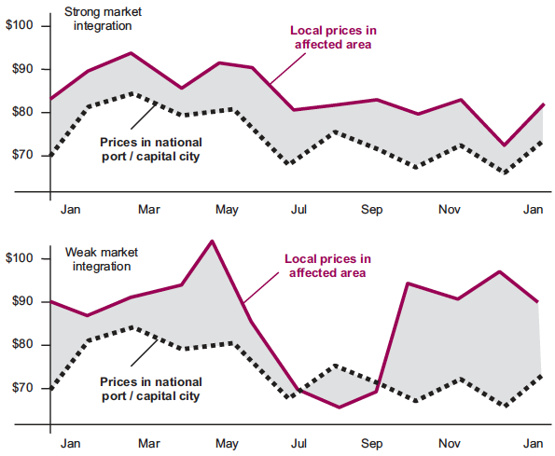
Are these markets integrated?
Notes:
BEN
Key information - to share
Strongly integrated markets:
Prices tend to follow similar seasonal patterns, rising and falling in unison
The price difference between markets stays relatively constant (grey shading in graph 1)
Weakly integrated markets:
Prices tend to follow dissimilar patterns
Big seasonal variations occur in the price difference between markets (grey shading in graph 2)
Source: EMMA Toolkit, pg 142.

Slide 107
Are these markets integrated?
Notes:
BEN
Maize markets in southern Ethiopia 2006-2011.
Source: WFP

Slide 108
Market power
Supply and demand,
Market integration
Market system context
Market power
The ability of an enterprise, trader, or other market actor to alter the price of a good or service without losing all their customers, suppliers or employees to their competitors.
In an ideal, perfectly competitive market, market actors would have no market power. However in the real world, barriers to entry, entrenched gender and social relations, collusion and other anti-competitive forms of conduct often enable some market actors to dominate price negotiations.
Also refer to monopoly, competition, cartel.
Notes:
INES
Market power
Objective: brainstorming different forms of infrastructure and services
Resources needed: flipchart, pens
With just title on slide, Elicit what participants think market power is. Click slide to get definition. Read definition (above).
o Competition = rivalry in the market place; where buyers/sellers have real choice between alternative market actors.
o Opposite is market power, especially monopoly. Arises when a single market actor – or small cartel in collusion – able to dictate/strongly influence prices, so excess profits or control over resources, services or knowledge.
Ask participants how they think they could ‘see’ market power (number of actors, conditions of trade, variability of conditions of trade, price, access). Give examples of market power and the impact of cartels. How can we address this?
Competition and market power are dimensions of market conduct. There is positive and negative aspects of market conduct – they include the following:
Positive aspects of conduct may include the following:
competition: households have a good choice of alternative suppliers (retailers, traders);
embedded services: wholesalers and retailers offer credit or other services to their customers;
risk management: businesses guarantee sales or advance loans to their suppliers (e.g. farmers);
collective market power: small-scale farmers market their produce collectively.
Negative aspects of conduct could include:
monopolistic behaviour: collusion by groups of traders (cartels) to influence prices in their favour;
market distortion: prices are set by government in ways which disadvantage the vulnerable or depress economic activity;
exclusion / barriers to entry: restrictions on where and when certain actors can trade.
Resources: Market power definition page 143
Changes in competition and market power p 151

Slide 109
Supply, demand, integration...
Market-system Map Template - TITLE
The market environment:
institutions, rules,
norms & trends
IMPORTANT ISSUE OR FACTOR
IMPORTANT ISSUE OR FACTOR
IMPORTANT ISSUE OR FACTOR
IMPORTANT ISSUE OR FACTOR
IMPORTANT ISSUE OR FACTOR
IMPORTANT ISSUE OR FACTOR
IMPORTANT ISSUE OR FACTOR
The market chain:
market actors & their linkages
Location Tag
INITIAL MARKET ACTOR
INTERMEDIATE ACTOR
V = ?
FINAL ACTOR BUYER / CONSUMER
INITIAL MARKET ACTOR
INTERMEDIATE ACTOR
P = ?
FINAL ACTOR BUYER / CONSUMER
N = ?
INITIAL MARKET ACTOR
INTERMEDIATE ACTOR
FINAL ACTOR BUYER / CONSUMER
INITIAL MARKET ACTOR
INTERMEDIATE ACTOR
INFRASTRUCTURE OR SERVICE
INFRASTRUCTURE OR SERVICE
INFRASTRUCTURE OR SERVICE
Key infrastructure, inputs
and market-support services
INFRASTRUCTURE OR SERVICE
INFRASTRUCTURE OR SERVICE

Slide 110
Market system context
Supply and demand,
Market integration
Market system context
Market power
The market system context is made of 2 sub-sections:
Key Infrastructure: inputs and services
Market environment: Institutions, rules, norms and trends
Notes:
INES

Slide 111
Infrastructure, inputs and services
Market-system Map Template - TITLE
The market environment:
institutions, rules,
norms & trends
IMPORTANT ISSUE OR FACTOR
IMPORTANT ISSUE OR FACTOR
IMPORTANT ISSUE OR FACTOR
IMPORTANT ISSUE OR FACTOR
IMPORTANT ISSUE OR FACTOR
IMPORTANT ISSUE OR FACTOR
IMPORTANT ISSUE OR FACTOR
The market chain:
market actors & their linkages
Location Tag
INITIAL MARKET ACTOR
INTERMEDIATE ACTOR
V = ?
FINAL ACTOR BUYER / CONSUMER
INITIAL MARKET ACTOR
INTERMEDIATE ACTOR
P = ?
FINAL ACTOR BUYER / CONSUMER
N = ?
INITIAL MARKET ACTOR
INTERMEDIATE ACTOR
FINAL ACTOR BUYER / CONSUMER
INITIAL MARKET ACTOR
INTERMEDIATE ACTOR
INFRASTRUCTURE OR SERVICE
INFRASTRUCTURE OR SERVICE
INFRASTRUCTURE OR SERVICE
Key infrastructure, inputs
and market-support services
INFRASTRUCTURE OR SERVICE
INFRASTRUCTURE OR SERVICE
Notes:
INES
Remind participants of the mapping exercises that they have done (taxi etc) and what the 3 different levels of focus are:
Institutions, rules, norms, trends,
Market actors and their linkages
Key infrastructure, inputs and market support services
Ask the participants to offer ideas of what the key infrastructure, inputs and market support services in a variety of markets to elicit ideas about what these are:
Ie. In a fishing market (storage, transportation, ice....)
Maize markets (farm inputs, warehouse services, credit, rural buses, electricity....etc)

Slide 112
Infrastructure, inputs and services
Examples of infrastructure and business services include:
• water and electricity utilities;
• input supplies (seeds, livestock, fertilizers, etc.);
• market information services (about prices, trends, buyers, suppliers);
• financial services (such as credit, savings, or insurance);
• transport services and infrastructure;
• technical expertise and business advice.
Notes:
INES
Different actors always depend upon various forms of supporting infrastructure, inputs, and services from other enterprises, organizations, and governments.

Slide 113
Institutions, rules, norms and trends
Market-system Map Template - TITLE
The market environment:
institutions, rules,
norms & trends
IMPORTANT ISSUE OR FACTOR
IMPORTANT ISSUE OR FACTOR
IMPORTANT ISSUE OR FACTOR
IMPORTANT ISSUE OR FACTOR
IMPORTANT ISSUE OR FACTOR
IMPORTANT ISSUE OR FACTOR
IMPORTANT ISSUE OR FACTOR
The market chain:
market actors & their linkages
Location Tag
INITIAL MARKET ACTOR
INTERMEDIATE ACTOR
V = ?
FINAL ACTOR BUYER / CONSUMER
INITIAL MARKET ACTOR
INTERMEDIATE ACTOR
P = ?
FINAL ACTOR BUYER / CONSUMER
N = ?
INITIAL MARKET ACTOR
INTERMEDIATE ACTOR
FINAL ACTOR BUYER / CONSUMER
INITIAL MARKET ACTOR
INTERMEDIATE ACTOR
INFRASTRUCTURE OR SERVICE
INFRASTRUCTURE OR SERVICE
INFRASTRUCTURE OR SERVICE
Key infrastructure, inputs
and market-support services
INFRASTRUCTURE OR SERVICE
INFRASTRUCTURE OR SERVICE
Notes:
INES
So, now we are looking at the market environment: institutions, rules, norms and trends
The market environment is the place to look at the issues and trends that are significant influences on the market environment in which producers, traders, and other market actors operate. This environment is shaped by various policies, regulations, social and business practices, and trends.
Elicit from participants what they think some of these may be......(tarriff regimes, bank interest rates, weather related risks, restrictive social norms, corruption amoung market officials....)
The market environment is also a good place to highlight any major long-term trends that were affecting the market system and target population even before the emergency: for example, economic trends, climate changes, population movements, and natural-resource constraints.
• Environmental trends, such as natural-resource depletion or climate change, that are affecting actors in the market system.
• Economic trends, for example in the international price of the critical food or item, or the value of the local currency.

Slide 114
Institutions, rules, norms and trends
weakness in the basic rules and institutions needed to help the market system to work effectively (e.g. contract-enforcement systems, land registries, producer organizations, trading standards);
official rules and policies – by-laws, licensing regulations, taxes – which hinder and block rather than assist market-system functioning;
arbitrary small-scale abuses of power by people in roles of authority (corruption and bribery);
socially enforced roles and rules that obstruct some people from participating in certain kinds of activity, or block their access to markets, on the basis of gender, ethnicity, etc.
Notes:
INES
The market environment is the place to look at the issues and trends that are significant influences on the market environment in which producers, traders, and other market actors operate. This environment is shaped by various policies, regulations, social and business practices, and trends.

Slide 115
Measuring the market…
SEASONALITY
OPTIMAL IGNORANCE
APPROPRIATE IMPRECISION
Notes:
BEN
Remind participants the we have been thinking about WHAT WE MEASURE to understand market performance
Where do we find the information?
The level of detail depends on the information gaps to be covered

Slide 116
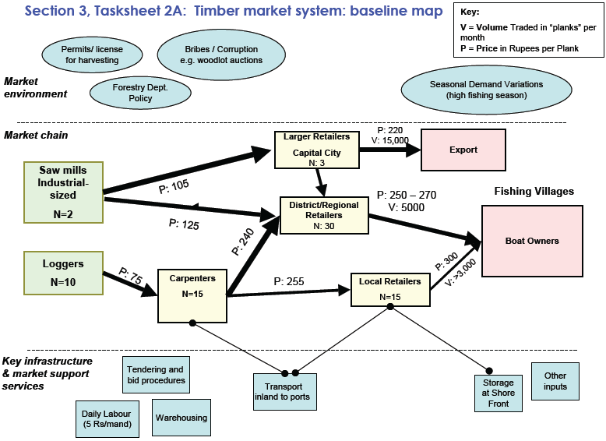
Notes:
BEN
Timber Market mapping (30 minutes)
Objective: to understand how maps can convey information about market performance
Resources needed: activity sheets with timber maps, and slide/poster of questions
Share the timber maps – baseline and emergency
Set task. In groups, can the participants answer the following questions?
Which areas are the most affected? (transportation routes, carpenters, regional retailers, warehousing)
How are the poor, fishing boat owners affected? (prices have gone up, especially from local retailers)
How were the Regional Retailers affected? (volumes reduced, prices increased)
Profit Margins: Who may be taking advantage of the situation with a higher profit margin? (local retailers)
How might the higher profit margin of the local retailers be justified? (volumes reduced)
What is the affect on the export market? (some reduction, but not to the same extent as that affecting domestic sales, possibly indicating unaffected trade routes)
How has competition in this Market system changed since the emergency? (number of retailers reduced)
How have volumes and prices changed since the shock and what does this say about changes to Supply/Demand? (volumes have gone down and prices gone up; restrictions in supply)
Supporting Resources
Emma toolkit pages 115 - 126

Slide 117
Activity: Timber market system
How has the timber market system been affected? What do the maps tell you in terms of:
  What are the most affected actors and areas?
  What can we observe in terms of changes in interaction between supply & demand? (on the basis of analysis of prices and volumes)
  Market power: how has the competition in this market system changed since the emergency?
  Who may be taking advantage of the situation with a higher profit margin?
  Can we conclude on market integration from the map?
Notes:
117
BEN
You have 30 minutes for this exercise

Slide 118
Visualising impact and issues
l | Partial disruption
X | Significant disruption
! | Critical issue
⬆⬇ | Increase, decrease (Price, Number, Volume)
? | Uncertainty; better understanding required

Slide 119
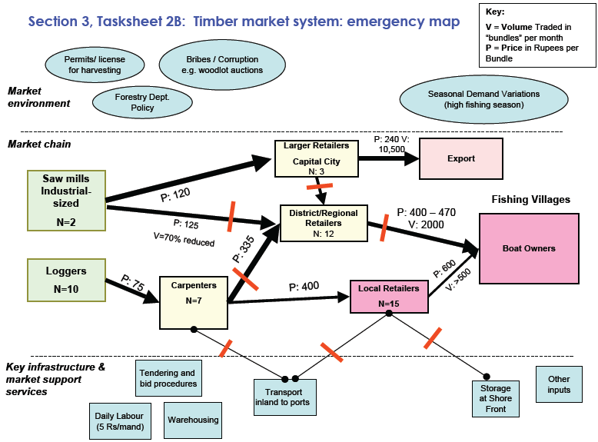
Notes:
BEN
Set task. Additional and supporting questions include.....
Which areas are the most affected? (transportation routes, carpenters, regional retailers, warehousing)
How are the poor, fishing boat owners affected? (prices have gone up, especially from local retailers)
How were the Regional Retailers affected? (volumes reduced, prices increased)
Profit Margins: Who may be taking advantage of the situation with a higher profit margin? (local retailers)
How might the higher profit margin of the local retailers be justified? (volumes reduced)
What is the affect on the export market? (some reduction, but not to the same extent as that affecting domestic sales, possibly indicating unaffected trade routes)
How has competition in this Market system changed since the emergency? (number of retailers reduced)
How have volumes and prices changed since the shock and what does this say about changes to Supply/Demand? (volumes have gone down and prices gone up; restrictions in supply)
Supporting Resources
Emma toolkit pages 115 – 126

Slide 120
Gap Analysis
Notes:
INES

Slide 121
Session outcomes
By the end of the session, participants will be able to:
Understand the concept of gap analysis
Carry out gap analysis
Anticipate direct and indirect market response options in assessment planning (think broadly!)
Notes:
INES
Recap on three stands of EMMA – gap analysis (understanding the priority needs of the target population), market analysis (understanding each critical market system in terms of its constraints and capabilities to play a role in the emergency response), response analysis (exploring different possible responses).
Gap analysis can be focused by asking:
What are the (quantitative and qualitative) needs of targeted populations / groups with regards to the critical market (key needs)?
How does the target population / group relate (interact / depend) to the market?
Remember to think broadly – depending on agency response intentions, mandate and capacity, how can we propose a wider range of response options that look at market support or go beyond preparedness to emergencies but can also think to strengthen access to basic goods, services and income markets now.

Slide 122
Market Capacity
Support to market
HH’s NEEDS
EXPANDABILITY post-emergency
BASELINE
EMERGENCY
Notes:
INES
What is the household gap?
Even if we are looking at the capacity of the market to cover the HH gap, we need to know if the market can cover all the needs
EMMAs core logic is based on:
Baseline: How was the market system functioning before the emergency?
Emergency: How has the market system been affected by the emergency? How does it function now? What are the major constraints affecting the market? How can they be mitigated?
Expandability: What is the expandability of the market capacity? How could it be reached? Expandability is about what the potential of the market could be if carefully designed responses were able to strength its operation and functionality. For this we need to know how the market functions under certain conditions.
These questions help to determine the capacity of market to meet the gap between peoples’ needs and access to critical commodities/income, and under which conditions

Slide 123
Market Capacity and Expandability
People’s Needs
Market Capacity and Expandability
HH
SHORTFALL
EXPANDABILITY post-emergency
PEOPLE’s NEEDS
BASELINE
Market support
CHRONIC
NEEDS
EMERGENCY NEEDS
EMERGENCY
WHAT PEOPLE CAN COVER
TOTAL NEEDS
Notes:
INES
When you are using pre-crisis market assessments, (in slow onset crises, or when dealing with preparedness, contingency planning or mitigation), the gap analysis will more than likely have emergency needs, and chronic needs.
This slide is animated – so that it shows in order:
1 – similar to last slide (just adds in what people needs people can cover – coping strategies)
looking at the needs, what people can cover, where the baseline assessment shows the market able to meet needs, with emergency and expandability
Then shows that actually, in many cases in using pre-crisis market analysis, can identify chronic shortfall of needs (gap between what people need and what they can access/what markets can cover)
Understanding the gap between emergency and chronic needs and how they are being met both in emergency contexts and in day-to-day contexts allows people to understand market functioning for preparedness as well as underlying structural market systems issues that could be addressed earlier. (no regret activities, longer term development links etc)

Slide 124
The Mukuru experience
The objectives of the assessment were to:
Design and carry out baseline and emergency market analysis to inform response design for any slow onset emergency in Nairobi informal settlements. As well as to inform preparedness, contingency planning and disaster risk reduction (where possible)
Propose innovative programming combining different types of direct and indirect interventions
Identify relevant parameters to be monitored to update baseline analysis and, in case of emergency, to inform response design
Notes:
BEN
Pre-crisis market analysis, as mentioned in the previous slides, allows people to understand current (non crisis) needs and state of the market and to forecast emergency needs and market functionality in crisis contexts.
This happened during a pre-crisis market assessment in the slums of Mukuru in Nairobi.

Slide 125
The Mukuru assessment context
The second half of 2011 saw one of the worst droughts of recent years
National emergency declared
Economy in crisis – high inflation, rising fuel prices and a weakened currency
Rocketing food prices. FEWSNET found that by June 2011, the staple food – maize - had increased in price by 112% since the beginning of the year.
Nairobi’s urban populations are especially vulnerable to rising prices - highly dependent on the market as the major source of all their household food and non-food needs (up to 90% for very poor households).
Due to soaring prices, large numbers of residents unable to meet their food needs. This led to negative and corrosive coping strategies. Treatment of severe acute malnutrition increased by 62% between January and May 2011.
Notes:
BEN
The market assessment team was led by Oxfam GB, but included staff from three other international agencies together with three local partner organisations.
In this assessment, June 2013 was selected to represent the baseline year, with June 2011 signifying the emergency year.

Slide 126
Mukuru wealth groups
Category | 1.Wealthy | 2. Middle Poor | 3. Chronic Poor | 4. Very poor
Average Income in (Ksh) | 200,000 – 300,000 | 100,000 – 200,000 | 40,000 - 100,000 | 20,000 - 40,000
Minimum food basket with rent 60,000
Deficit | 0 | 0 | 0 - 20,000 | 20,000 – 40,000
Population % in 2007 | 10 | 40 | 40 | 10
Population % in 2008 | 10 | 20 | 50 | 20
Livelihood Trends 2008 | In some cases, business has expanded. More generally, incomes and productivity have reduced resulting in decreased unskilled labour opportunities for wealth group (WG) 3 and WG4 | Squeeze on formal employment (as some factories have closed). Tribalism has fractured the job market, reducing flexibility of employment. Reduced profits on medium enterprise by up to 50%..) | ‘There is no casual labour anymore’ Many micro-businesses have closed (up to 75% ) “Laundry job fetches 30/- or even 10/-”. (Mukuru Focus Group Discussion). Increased competition due to influx of IDPs into urban areas. Police harassment has reduced hawking options Scavenging is estimated to have risen to 40% of young boys | Markets for scavenged metals have reduced due to squeeze on informal industries. This results in intense competition. Illegal brewing business has increased because of stress led demand, but criminal activity and lack of security means theft is common. Prostitution is estimated to have risen to 30% of in Korogocho
Safety Nets | Decreased capacity to support poorer kin & neighbours | Less capacity to support poorer neighbours and friends | Less support from wealthier kin
Notes:
BEN
People living in the informal settlements of Nairobi constitute around 60% of the city’s population. They depend on precarious livelihood strategies, predominantly from micro and small enterprises and from casual jobs.
A recent Oxfam report has found that there are four distinct wealth groups in Nairobi’s informal settlements. These groups comprise the wealthy (10%), middle poor (20%), chronic poor (50%) and the very poor (10%).
Heyer and A. Crosskey (2008) ‘Oxfam Response to Urban Food Crisis: A Situational Analysis and Strategy Options’, Oxford: Oxfam
The breakdown of wealth groups has raised a number of key points.
1. Livelihoods are precarious. During an emergency it was observed that the number of people that can be categorised as being part of the wealthy group generally remains relatively stable. However, during crises and periods of economic stress, a significant number of people from the middle poor group slide down into the chronic poor wealth group. Similarly, significant numbers of the chronic poor also shift into the lower very poor wealth group. This highlights that the majority of the inhabitants of the informal settlements lack any effective resilience to crises.
2. his wealth group breakdown clearly points out the disparity between minimum estimated food and rent needs, and actual income, in an average non-emergency year.
The ‘very poor’ wealth group typically has an annual average income of 20,000 to 40,000 Kenyan shillings (approx. $247 - $ 494 USD). In comparison, the income required to cover basic needs is about 60,000 Kenyan shillings (approx. $741 USD) leaving a deficit of 40,000 to 20,000 Kenyan shillings.

Slide 127

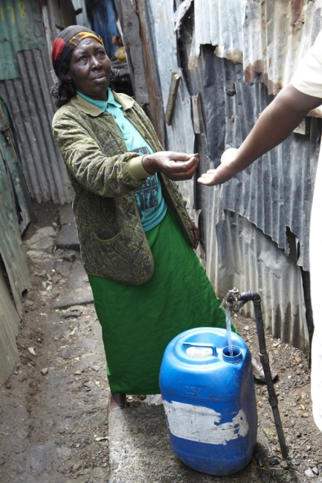
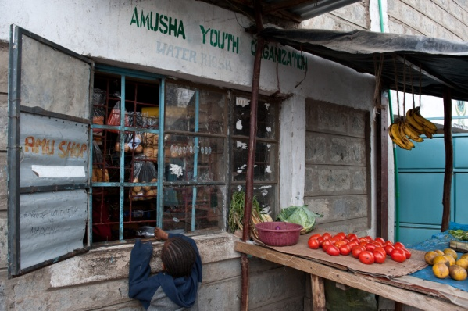
Critical markets selected
Based on needs analysis, the markets selected in Mukuru informal settlement were:
maize and water (critical to survival needs)
and the market systems that enabled access to credit (vital for livelihood protection and promotion).
Notes:
BEN

Slide 128
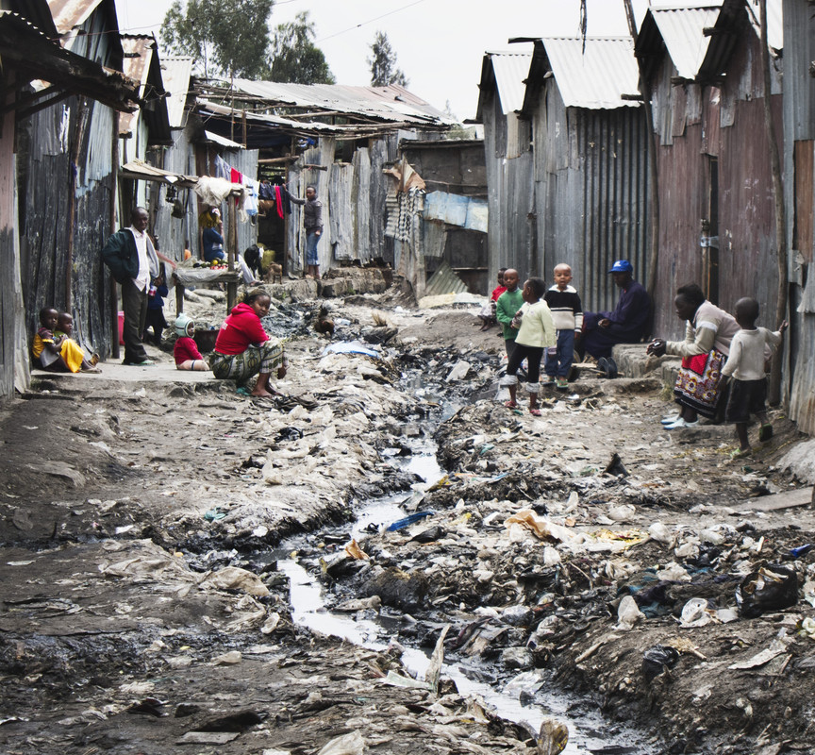
Key findings
The emergency is now.
Across the different critical markets teams, the same message was echoed - “the emergency is now”.
Even in the non-emergency context in Mukuru, people are living far below the SPHERE standards.
Is it sufficient to wait until there is a crisis to design responses to address both chronic and emergency needs?
Designing responses that seek to support survival and protect livelihood needs now will strengthen the resilience of the targeted groups when there is a crisis.
Notes:
INES

Slide 129
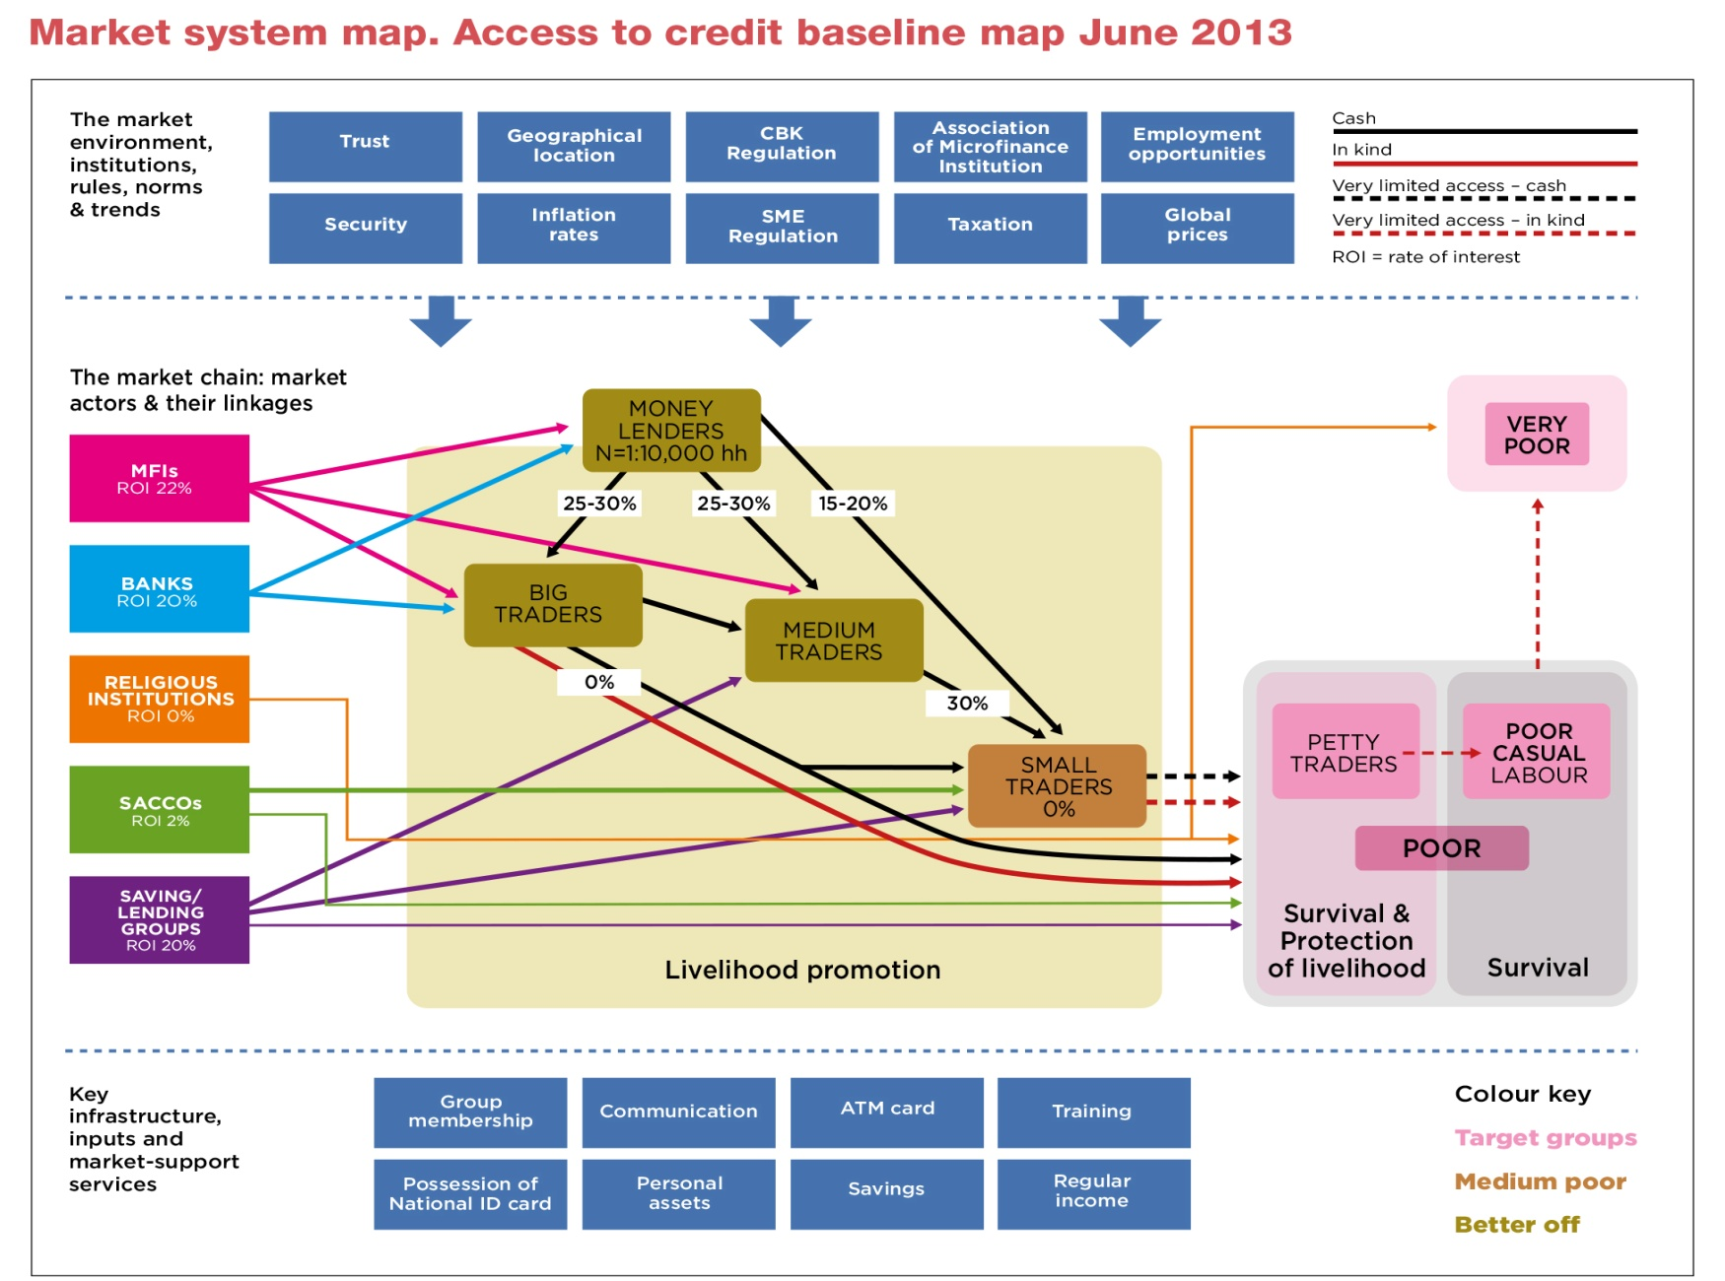
The baseline credit markets system
Notes:
In the context of the informal settlements, characterised by income poverty and insecurity, a lack of social protection, a heavily market based economy - access to credit is vital.
The Kenya Food Security Steering Group of 2011 , gauged that, in emergencies, 40% of the urban population is dependent on accessing credit to buy food. Kenya Food Security Steering Group (KFSSG) Short Rains Assessment Survey (February 2011),
Many forms of formal and informal credit, accessed by different groups, predominantly because of pre-conditions set to access credit. Small traders (middle poor) very important in the credit market system and provide essential credit to a number of poorer households, ranging from Ksh 200-300 per person at any given time.
Mukuru’s poor wealth group depends on casual jobs and petty trade for income. Those in casual jobs have a highly volatile income, and for those engaged in petty trade have limited funds to secure sufficient business capital.
To address regular household needs, the majority of this group access credit either in kind (in the form of food from other petty traders), or, much less frequently, in cash from local chama. This type of credit serves to meet this groups’ survival needs – in that it allows for the poor to access enough food for the day, or to restock their shops on a very small scale.
In turn, the poor are also an essential part of the market system, in that they lend to the very poor. This is mostly in kind, through food credit, although food donations are also common.
The very poor lack any real access to credit. This group does not have any regular source of income and mostly depends on gifts and donations from neighbours and friends.

Slide 130
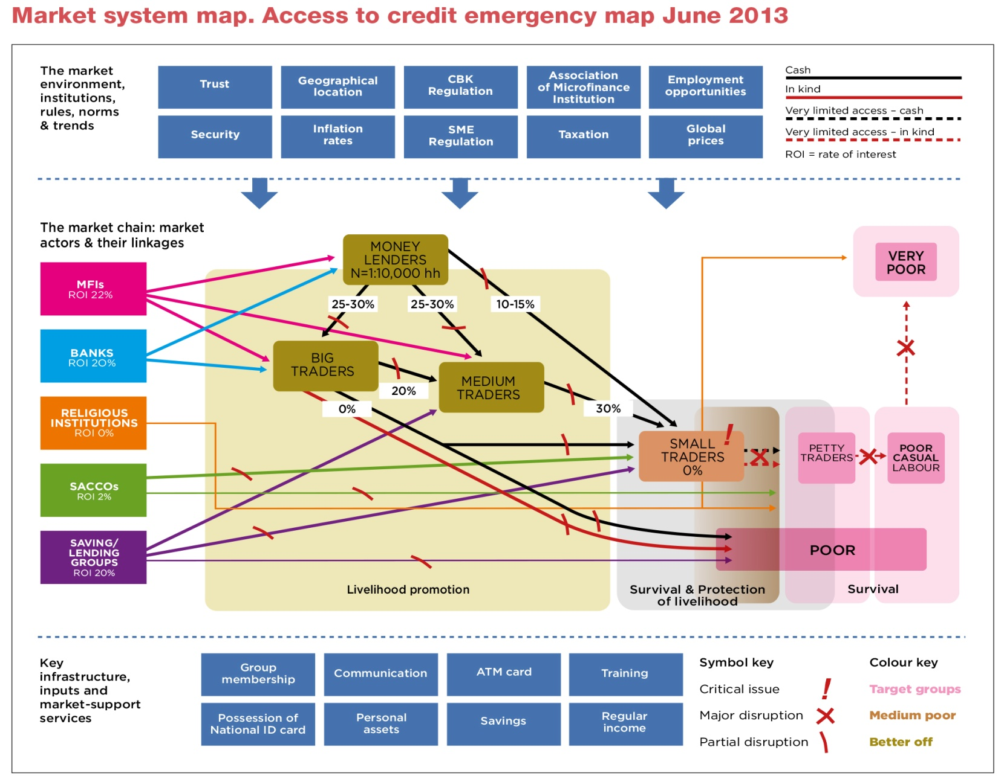
The emergency credit markets system
Notes:
During emergencies, small traders (middle poor) are likely to be greatly affected. During non-crisis (chronic) periods, this group is just able to cover their expenditure. In an emergency this group is unlikely to be able to maintain their livelihoods and will move to the poor wealth group. This has severe implications for their ability to provide essential credit to the target group. Reaching out to this group with a response mechanism will help to keep the credit links live and will also help in reducing the number of target population to be reached in the next crisis.
In emergencies, the poor do not give credit to the very poor. During the annual hunger period, the poor cut down on the number of meals they consume per day as well as cutting down on other expenses such as education, health and water and sanitation. During these times this group generally try and adopt many livelihood strategies to boost their incomes sufficiently to meet their survival needs. Due to the small scale of their businesses, emergencies significantly increase the risk of falling into the very poor wealth category.
For the very poor, emergencies signal the drying up of their already meagre sources of both credit and in kind donations. Credit tends to only be available to the very poor, from the religious institutions which offer very small scale cash credit of Ksh100.

Slide 131
Recommendations
Long term/ structural recommendations:
Advocacy with Government for safety nets for the very poor and poor (to address the chronic needs and provide a regular source of money).
Advocacy and lobbying for identity card registration to enable poor and very poor wealth groups access to wider sources of credit
Linking with institutions that could provide grants for the poor (individual and groups)
Promotion of Group Savings and Lending for the poor and very poor households
Skills training for poor households for livelihood protection and promotion.
Emergency recommendations:
Cash injection to poor households
Cash grants for Protection of livelihoods for small traders
Notes:
INES
This assessment strongly demonstrated that, while it is necessary to be better prepared to understand and respond to emergency survival needs.... market analysis can produce repose options that deal with the very real chronic needs faced by many populations.
It showed that it is relevant, appropriate and necessary to look beyond survival needs to analyse what is necessary to support livelihood protection and promotion.

Slide 132
Gap analysis
What are the (quantitative and qualitative) needs of targeted populations / groups with regards to the critical market (key needs)?
How does the target population / group relate (interact / depend) to the market?
Notes:
INES
Refer to EMMA toolkit, Gap Analysis, starting on page 127.

Slide 133
Gap analysis: Numerical gap analysis
Estimate of gaps facing target population:
Duration: How long gap might last
Preferences: Target HH considerations
Other assistance: What else is in the pipeline
Sources: initial needs assessment, sample interviews, seasonal calendars, other agencies, coordination meetings
Notes:
INES

Slide 134
Gap analysis: Qualitative issues
Constraints on access
Transport needs
Ethnic, gender, other vulnerability issues
Seasonal factors
Coping strategies
Preferences
Risks or challenges that eliminate a particular response
Notes:
BEN

Slide 135
Gap analysis: Target population details
Target group | Female | Male | Location | Essential charater-istics

Slide 136
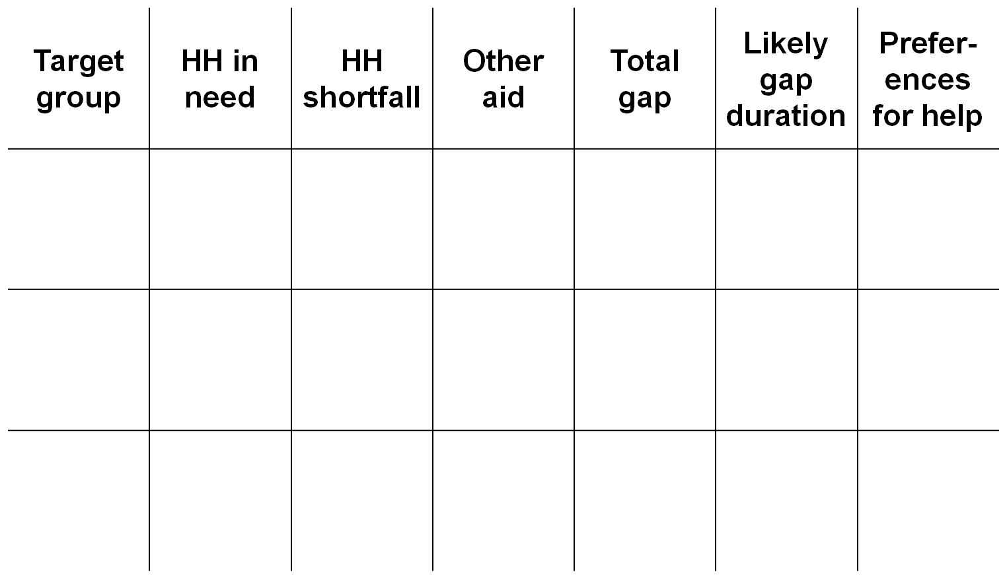
Gap analysis
Notes:
BEN
THIS IS THE ONLY SLIDE ABOUT WHICH I HAVE QUESTIONS
Depending on the context and objective of the market assessment, together with the capacity of the participants, you can select the straight forward gap analysis table, or the gap analysis table that also records chronic needs.
THIS FIRST TABLE TRIES TO MEASURE THE GAP IN AN EMERGENCY.
If you record chronic needs –this will enrich the response recommendations, not only for preparedness and contingency planning for survival needs, but also for immediate short-longer term livelihood protection and promotion.
IF YOU WANT TO INCLUDE EMERGENCY AND CHRONIS NEEDS – YOU COULD USE THE SECOND TABLE ON THE NEXT SLIDE

Slide 137
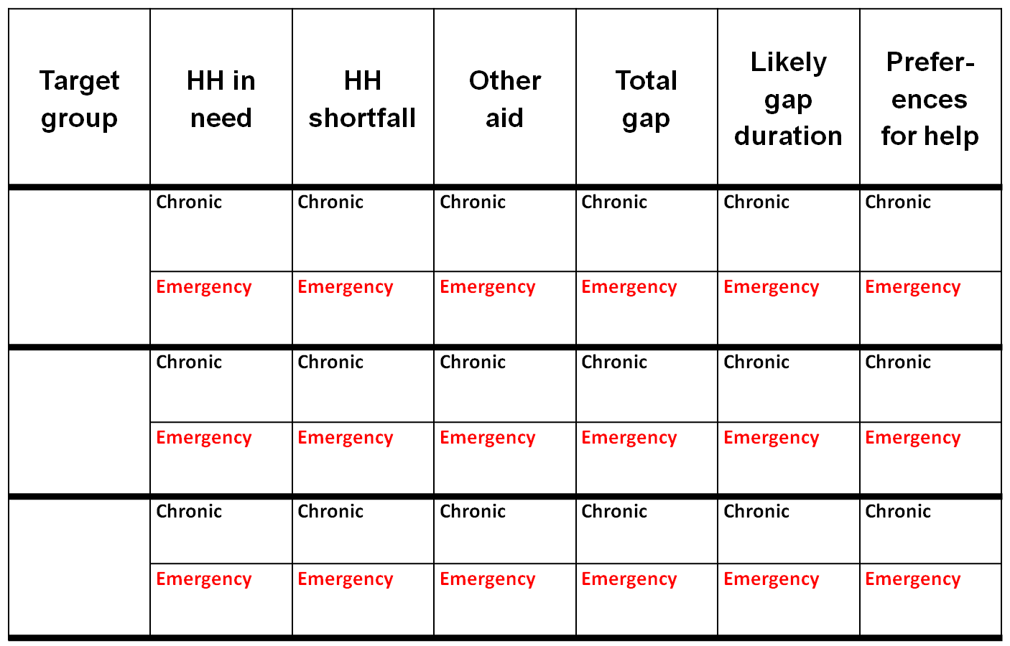
Notes:
Ensure that participants know that if they want to look at chronic alongside emergency needs, this will have to followed through into the questionnaire.

Slide 138
Activity: Completing the preliminary analysis
Basing your work on the tables shown in the previous slides, calculate the gap.
Notes:
BEN

Slide 139
Preparation and field work
Notes:
It is essential that the groups come back together each evening after fieldwork to discuss findings and re-prioritise fieldwork activities. As this is an iterative process, key analytical questions may change. This process will enable the facilitator, team leaders and participants to reflect on findings to date (including assumptions made about the target group, needs, and the initial market system), how this fits into the evolving theory of how the market system functions, and what they need to find out next.
Data collection is an iterative process that will lead to the formulation and reformulation of ideas about the relationships in the market system, volumes and prices. Data collection allows you to hypothesise, verify, quantify and adapt.

Slide 140
Session outcomes
By the end of the session, participants will be able to:
Understand fieldwork commitments
Understand what decisions need to be taken in the fieldwork
Prepare a questionnaire for their market system
Notes:
Before beginning the fieldwork and analysis, it is critical to understand the breadth of the possible responses. Are you looking to understand just baseline needs and emergency needs (for preparedness or emergency response), or do you want to take a broader perspective and look at baseline, emergency and ideal needs, to allow the creation of longer term and broader responses options.
It is also necessary to ensure that we have a shared understanding of who the target group are. For example, if we are looking at the poor and very poor wealth groups, how will we distinguish these? What will some of the defining characteristics be?
Areas selected for the assessment should offer some comparison, so that the fuller picture of the market systems for the target groups emerges.
It is important to coordinate with other teams, so that there is not an influx of fieldwork activities all in the same area, at the same time. Moreover, coordination may mean that teams covering market system A, can ask questions on behalf of the team looking at market system B. Clearly, this will need thinking through to see if it is appropriate. It is also important to think though how the teams will be organised throughout the fieldwork. Is it better to conduct interviews as individuals, in pairs, in groups? Are there any gender issues that you need to think through in terms of interviewing.
It is important to aim to have balanced teams and balance within teams. You may wish to consider: gender, sectoral experience, capacity, domestic and international staff,
local language speakers, partners and NGOs
It is always important to try generate a gender perspective of the market system. As such, it is a good idea to ask in interviews about the role of gender in the market chain and market environment.

Slide 141
Activity: Preparing field work
Considered how you will identify your target group
List the actors that you will interview to complete maps and analysis
Organise fieldwork and share tasks among your group
Notes:
Who, where and how? (20 minutes)
Objective: to develop a shared understanding of the fieldwork
Resources needed: flipchart to record information, maps of the area
Write Who, Where and How on three separate flipchart sheets. In plenary, discuss:
How we can distinguish the target group. What are their typical characteristics?
Where are the areas we will work (finding 2-3 for comparison purposes). Why are we choosing these areas?
How can we organise our teams to ensure better working practices. This could involve sharing a few critical questions, and will include questions of how to avoid overlap, how the teams will be divided for interviews, and what logistics should we consider
In designing fieldwork – we need to understand:
How we can identify our target group;
Which areas will be selected for interviews and why;
Which actors/households/authorities will be interviewed;
Which methodology will be followed (focus group discussion, household interview? Stakeholder interview);
How the teams will be organised;
How we can coordinate with other teams;
How the data collection is planned;
What is the plan for data collection over the length of the fieldwork days;
The data collection questionnaires.
Resources: EMMA toolkit Step 4 page 75

Slide 142
Activity: Preparing field work
Prepare interview questions
Notes:
Designing questionnaires (1 hour 15)
Objective: to design a questionnaire
Resources needed: resources for transcribing agreed questionnaires (paper, pens, computers, printer etc)
In groups, recap the information that is needed to understand the market system. Recall the key analytical questions. In groups agree on:
List the actors that you will interview to complete maps and analysis
Prepare interview questions
Organize fieldwork and share tasks among your group
Share the questionnaires for feedback from the larger group. Print and prepare for the field.

Slide 143
8

Slide 144
Analysing the Field Work

Slide 145
Session outcomes
By the end of the session, participants will be able to:
Present analysis from the field

Slide 146
Activity: Group Presentations
Each group presents to the whole group:
Household typology
Gap analysis
Seasonal calendar
Market maps
Notes:
Presentation of results, per critical market, per group (30 mins)
Objective: to present work and data collected
Resources needed: maps, household typology/information, seasonal calendar, gap analysis
Each group presents to the whole group:
HH typology
Gap analysis
Seasonal calendar
Market maps

Slide 147
Market analysis
On the basis of the market system map, identify any substantial issues (that would influence your response design); focus on issues of:
  Market power: is there power concentration and where?;
  Market integration: is the market system integrated?;
  Environment, and infrastructure: are there constraints and limitations?
  In emergency who is the most affected?
  What affects the access of the target group to the market system in ‘chronic’ and ‘emergency’ contexts? (what prevents a fairer access?)
Focus on what will have an impact on your project design.
Conclude:
  Is it a supply side or demand side problem?
  In emergency, can the market cover the gap for the target group? Can we use the market to deliver the response?
  In chronic situation, can the market cover the gap for the TG?
During the whole discussion, record opportunities and bottlenecks / threats.
Notes:
Gap and market analysis (1 ½ hours)
Objective: to understand what the maps indicate
Resources needed: market maps generated by each group
On the basis of the market system map, gap and market analysis, ask each group each to identify opportunities and bottlenecks / constraints that would influence your response design looking at substantial issues on:
Market power;
Market integration;
Environment and regulations
Focus in particular on what will determine the project design.
Decide:
Is it a supply side or demand side problem?
Can the market cover the gap between forecasted/existing needs and what people can access?
Can we use the market to design the response? If yes, under which conditions.

Slide 148
9

Slide 149
Response analysis and recommendations
Notes:
Looking wider
The purpose of response analysis is to identify the responses that are most appropriate to local people, feasible, cost effective and cost efficient that can be implemented by Agencies, partners and other actors.
Response analysis comes directly after situation analysis in the programme cycle and feeds into response design and implementation.
This can be direct or indirect responses, and have an emergency, resilience building, early recovery and market support function.
Markets needs to be monitored on key parameters and indicators as early warning indicators, as part of contingency planning and preparedness.

Slide 150
What is the purpose of response analysis?
.....to identify the responses that are most appropriate to local people, feasible, cost effective and cost efficient that can be implemented by Agencies, partners and other actors.
Notes:
Ask the participants:
what are the implications of this definition for the information they will require to carry out a response analysis?
We need to know, which responses will
• most effectively meet needs
• do least harm
• culturally acceptable
• affordable
• timely
Roles & responsibilities of
• governments
• private sectors / markets
• LNGOs
• UN
• INGOs

Slide 151
Main messages
Households and communities have different vulnerabilities, capacities, priorities
These differences will be reflected in response objectives, targeting, and choice of modalities/ payment methods.
Modalities and amounts should anticipate changes to assets and coping strategies, based on analysis and intended thresholds.
Many risks can be anticipated in advance and mitigated with effective planning.

Slide 152
So when do we do response analysis?
Design
Build learning into new programmes
Implement
Response analysis & Identification
Learn
Monitor
Learn
Situation Analysis
Evaluate
Exit
Notes:
In the project management cycle......Response analysis is a separate activity to situation analysis
Discussion questions
why is it important that response analysis is separate from situation analysis ?
Can they think of an example of where a lack of response analysis leads to inappropriate response?
Answers
Ensures that the above factors are taken into consideration
Therefore ensures that responses are appropriate
Ensures international assistance does not undermine national capacities
An example is when the number of food insecure people is assumed to be the number of people needing in-kind food aid

Slide 153
What does response analysis need?
Recommendations must emerge from analysis.
Design
Understanding of WHO targeting, their vulnerabilities, the response objectives, targeting and risk.
Response analysis & Identification
Situation Analysis
includes needs analysis and market analysis.

Slide 154
Response analysis: rationale
Determine what response is most appropriate in each critical market system
Decide what type of direct assistance or indirect action (including further investigation) to recommend
Estimate how much assistance is required
Describe when, and for how long, assistance or indirect support should be provided, and how impact could be monitored

Slide 155
Recommendation analysis
Recommendations must emerge from our analysis
Can be a combination of CTP modalities
Can be a combination of cash and non-cash
Can be a combination of activities

Slide 156
Activity: Current Project and Strategies
Overview of current work in target area
Notes:
Current projects and strategies (30 minutes)
Objective: to understand what other responses are operating/projected in the target areas and to build response recommendations taking into account learning from past responses
Resources needed: presentation be focal point
Presentation of present or planned projects in the target areas (very quick presentation: objectives, activities, target groups and specific areas of engagement). This presentation is important to provide an overview of existing and planned programming, so that response recommendations take into account other initiatives and are embedded in strategy / programmes and seize opportunities of synergy / integration

Slide 157
Workshop focus
Mitigation and early ‘no regret’ activities
Humanitarian Response and Early Recovery
Sustainable Development
Preparedness
Disaster
Notes:
Emphasise that activities before and after an emergency should be complementary and with the overall aim of helping people to live independent, autonomous lives.
CTP provides a link between ‘life saving’ activities immediately after a disaster, and recovery activities, contributing to rebuilding infrastructure and livelihoods, and building on people’s capacities leading to sustainable development activities. This link is sometimes known as early recovery. Preparedness is essential when dealing in multi-sector response: agreeing modality, feasibility, etc in advance of the emergency is vital.
The separation of relief and recovery from sustainable development activities is not always satisfying to participants. All are important, but the bias here is partly the result of CaLP and ECHO mandates focusing on relief and recovery.

Slide 158
Market Based Programming
Market Indifferent
Market Based Relief
Indirect Support through Markets
Market Strengthening and Development
Objective: meeting basic needs (food security etc)
Objective: meeting basic needs through temporary interventions
Objective: economic recovery & strengthening
Activities:
In kind
Local and regional food purchase
Cash and vouchers
Seed fairs
Activities:
Targeted support to market actors (grants, loans, transport subsidies, temporary storage)
Support to supply
Activities:
Employment creation
financial services
Supply and value chains
Productive assets
Enterprise development
Notes:
Remind participants about the breadth of responses - from preparedness to mitigation and helping to build resislience.
Remind participants, too, about the breadth of market based programmes.
From the moment that the initial market analysis is done, response options can be designed and implemented, so that certain parts of the market are strengthened, helping to support both access to basic needs and livelihoods so that they could, potentially, better withstand shocks. This can begin to address the long term, or ‘chronic’ nature of vulnerability and poverty in some areas.

Slide 159
Response analysis: core logic 1
Meet basic survival needs
Protect livelihood assets and food security capabilities
Promoting economic livelihoods, supporting recovery, and restoring income

Slide 160
Response analysis: core logic 2
Responses that rely on local market systems performing well
Responses that aim to strengthen or support local market systems
Responses that do not rely on local market systems that are not performing well
Actions leading to further investigation, analysis, and monitoring

Slide 161
Activity: Response analysis and recommendations
Brainstorm potential response options and discuss advantages and disadvantages;
On flipcharts, for 3 to 5 preferred response options suggested by your response analysis, and for each of them, evaluate risks and assumptions, effects on markets and population, feasibility, timing and feasibility.
When discussing consider the following questions:
What responses could allow people meet their needs?
What would give a fairer access to the TG to the market systems, in emergency and chronic situations?
What actions or support to markets might allow responses to meet people’s needs and support market recovery / strengthening?
What could be the impact of different response options on markets and people’s access to market? What are the risks?
What actions could mitigate those risks?
Notes:
Response options and recommendation (2 hour)
Objective: to design response options and response recommendations
Resources needed: flipchart paper and pens for recording
Part 1 (1 hour)
Brainstorm potential response options and discuss advantages and disadvantages;
On flipcharts, for 3 to 5 preferred response options suggested by your response analysis, and for each of them, evaluate risks and assumptions, effects on markets and population, feasibility, timing and feasibility.
Out of the 1 hour, take 30 min to discuss operational details for the chosen modality (delivery mechanism, type of contract with traders / suppliers, who receives, who delivers, monitoring system, accountability system)
When listing the response options, include any recommendation including for preparedness / CP, DRR, early recovery as long as it comes directly from the present analysis
When discussing consider the following questions:
What responses could allow people meet their needs?
What would give a fairer access to the target group to the market systems, in emergency and chronic situations?
What actions or support to markets might allow responses to meet people’s needs and support market recovery / strengthening?
What could be the impact of different response options on markets and people’s access to market? What are the risks?
What actions could mitigate those risks?

Slide 162
Response options
Response option | Feasibility | Ad-vantages | Dis-advantages | Timing

Slide 163
Response recommendations
Activities | Risks & assump-tions | Timing issues | Effects on markets and pop. | Indicators
Notes:
Part 2 (1 hour)
Presentation of the response options to the groups
In plenary, agreement on:
Response recommendations
Recommended action points and further researches

Slide 164
What does it mean for our organisations?
How will we use this analysis?

Slide 165
Activity: Market monitoring and updating market maps
Identify key indicators that should be monitored as early warning indicators; Specify thresholds (for triggers) where possible & relevant;
How and when / how frequently should they be collected? Where can the information be found?
Identify key indicators / market parameters that should be updated in the market map prior to designing and planning an emergency response
How and when should they be collected?
Notes:
Monitoring markets
Objective: to design response options and response recommendations
Resources needed: flipchart paper and pens for recording
Discuss early warning systems and existing monitoring systems.
Brainstorm:
Identify key indicators that should be monitored as early warning indicators; Specify thresholds (for triggers) where possible & relevant;
How and when / how frequently should they be collected? Where can the information be found?
Identify key indicators / market parameters that should be updated in the market map prior to designing and planning an emergency response
How and when should they be collected?

Slide 166
Activity: Action plans
Notes:
Action plan (30 minutes)
Objective: to translate the learning into practice
Resources needed: flipchart paper and post it notes
Ask participants to think about what they will do next with this learning. Share.
Evaluation and Wrap up
Presentation to key stakeholder/other agencies (this can be done on a separate day)
Objective: to share findings and response recommendations
Resources needed: maps, seasonal calendars, household information, gap analysis, response options and recommendations
Presentations to key stakeholders, partners, other organisations

Slide 167
Resources
Markets in Crisis:
  https://dgroups.org/dfid/mic
ERC Project Website – coming soon!
Cash Learning Partnership (CaLP)
  http://cashlearning.org
  http://dgroups.org/CaLP
Emergency Market Mapping and Analysis
www.emma-toolkit.org
www.dgroups.org/dfid/emma
Sphere Project
www.sphereproject.org
  see page 200 for CTP standard

Slide 168
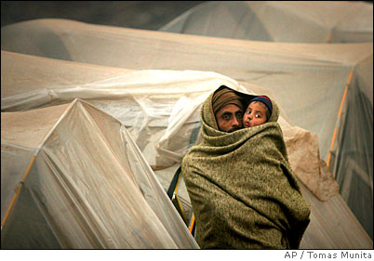
Thank you
Notes:
Photo credit: Tomas Munita/AP

Slide 169
Resources and Photo bank

Slide 170
Notes:
Back to the taxi market map => we did the baseline one, now we will do the emergency one

Slide 171
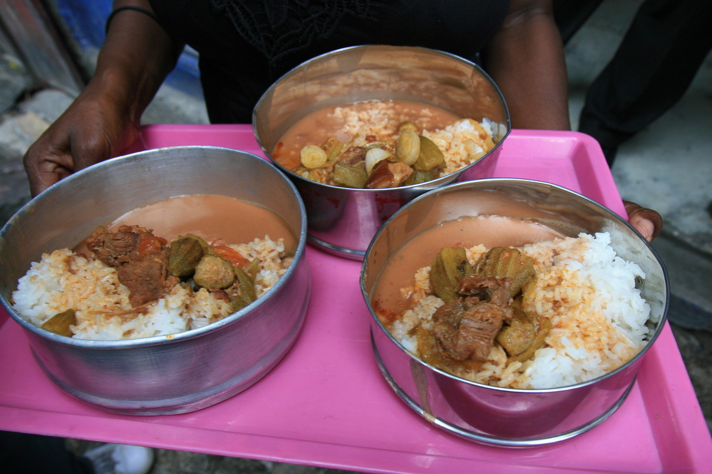
Notes:
Haiti Photo credit Jane Beesley/ Oxfam
Marie Carole is one of the 56 women who ran Oxfam’s very first community canteens. The canteens started in March 2010 and ran for two months in some of the areas of Port-au-Prince. Oxfam supported her financially so that she could feed 80 of the most vulnerable people in her immediate community and make a profit for herself, as a first step to regaining her own livelihood.

Slide 172

Notes:
Haiti – photo credit Kateryna Perus
Marie Carole – from the last slide....
‘With the grant we’ve been given -- and the loan we received from CECACHE thanks to Oxfam -- a lot of us got solid support that will empower even the worst affected people. In my case, the domestic responsibilities are major obstacle to my business expansion, but I’m confident. I know I’m not alone in this fight. I believe God is by my side. When I think about January 12th and the first days after this disaster, I can say there was no more hope. And now, it’s just amazing: I’m back on my feet!’

Slide 173
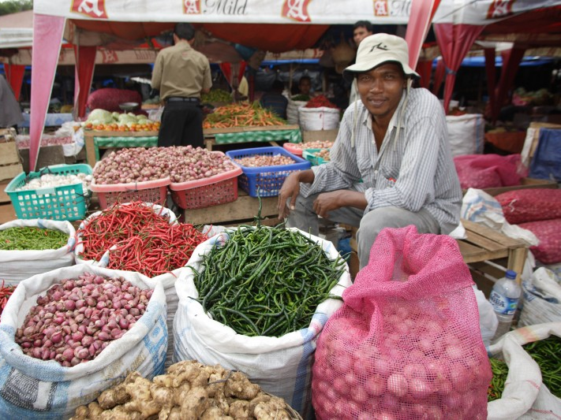
Notes:
Banda Aceh – immediate response post Tsunami photo credit Jim Holmes/ Oxfam
Caption
Traders and shoppers crowd Lambaro, the largest traditional market after the tsunami in Banda Aceh. There is fish, meat, fruit and vegetables.

Slide 174
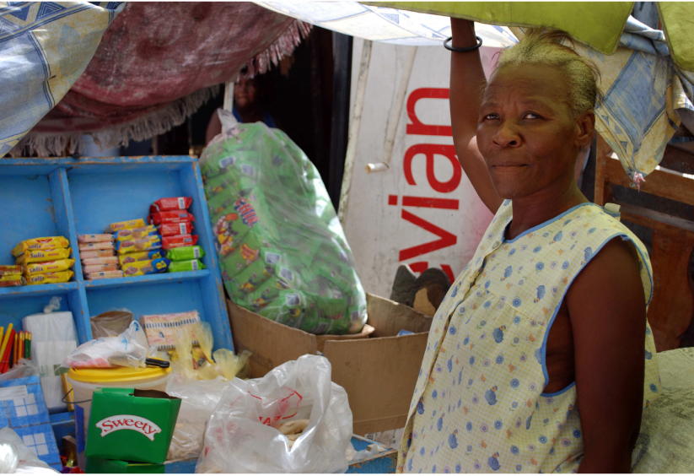
Notes:
Haiti post 2010 earthquake Copyright Kateryna Perus
“My situation was very bad, I lost everything: I lost my home and everything I used to sell, so I had nothing. I have been living in a tent with some sisters from my church. I used to sell things from a
stall downtown before the earthquake, and so when Oxfam gave me the money I was able to buy this stock and start working up here instead.”

Slide 175

Notes:
Yemen. Photo credit Caroline Gluck
Market trader in Bayt al-Faqih. Plenty to sell but few can afford the current high prices
Bayt al-Faqih. south of Hodeidah, is one of Yemen's biggest markets and open every Friday. This traditional market began in the 1700s when Bayt al Faqi was a coffee trading post.
Programme Information
Oxfam is giving cash grants to help people buy food and water to feed their families. In Al Hodeidah we have distributed cash transfers to 100,000 people across 870 remote villages, and provided training on safe hygiene practices.

Slide 176
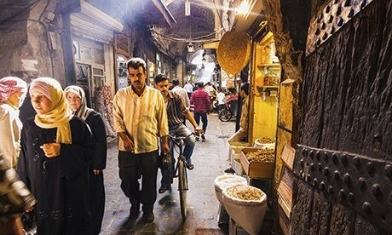

Slide 177
The Context in South Sudan (2011)
Abyei - small disputed area of land on the border of North and South Sudan
In anticipation of the July 2011 referendum - Southern Sudanese people began to return (approx 315,000 by early July). Many settled in Twic Country, in Warrap state.
The inhabitants of Twic County were struggling to accommodate large increase of vulnerable people.
Violent skirmishes and resulting occupation of Abyei by Sudan Armed Forces led to a further displacement - 113,000 according to UN – in Warrap State, Northern Bahr el Ghazal and Wau.
Moreover, the North had blocked main supply trade routes for the South (meaning over 3000 trucks waiting to head south with key food stuffs). This occurred in the traditional lean season. Livelihoods in North and South Sudan had been strongly linked and co-dependent.
Prices for staple foods in many South Sudan towns up by %40 and wide range of commodities disappeared from the market as traders struggled to find alternative trade routes
Due to displacement – land not been cultivated in primary planting season (previously agriculture met 40-50% of local needs and approx 19% of household income)
Notes:
The international community sought to address the immediate needs of the crisis affected population of Abyei and beyond, through the distribution of essential food and non food items. However, in addition to the need to provide immediate relief, solutions needed to be found that addressed the loss of agricultural assets. Without this component, many households would have struggled to cultivate in the 2012 season, thereby failing to protect their food and income security.
In this context, Mercy Corps and the Norwegian Refugee Council (NRC) decided to implement an EMMA to look specifically at the feasibility of market based interventions to assist with improving food security and access to shelter.
Access to key agricultural inputs through local markets:
The EMMA assessment specifically looked at the market systems for okra seeds and for malodas (local hoes), as they are commonly used and important agricultural inputs. The assessment looked at these specific products and mapped the market system to establish what changes have occurred as a result of the Abyei displacement crisis and the closure of supply routes from the north.
Particular challenges were that neither the movement of people nor the markets had yet stabilised.

Slide 178
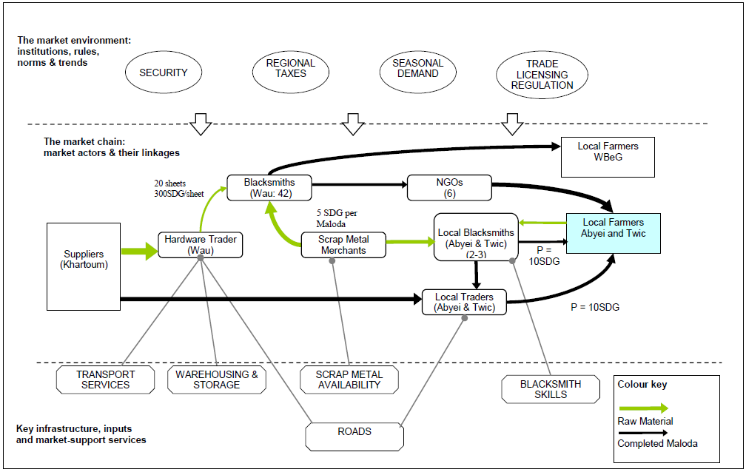
Market functionality in South Sudan…
The Maloda Metal Market – baseline map
Notes:
The Maloda Market
The EMMA found that for both IDPs and host communities, maloda, or traditional hoes, were considered a basic need. Prior to the crisis, it was common that farmers would take scrap metal to the blacksmiths, who would then turn the metal into a maloda. Additionally, as part of routine distributions, NGOs have regularly given alternative East African hoes to beneficiaries. These East African hoes, which are generally disliked by the beneficiaries, are also taken for reshaping at local blacksmiths.
The use of household income to adapt this tool, not only indicates how important they are to local agriculture, but also that households do have purchasing power for this commodity. In the planting season, it is common that all household members have a maloda, to help in the planting of crops. Therefore, despite the regular NGO distributions, there was still a viable market for malodas in the target area.

Slide 179
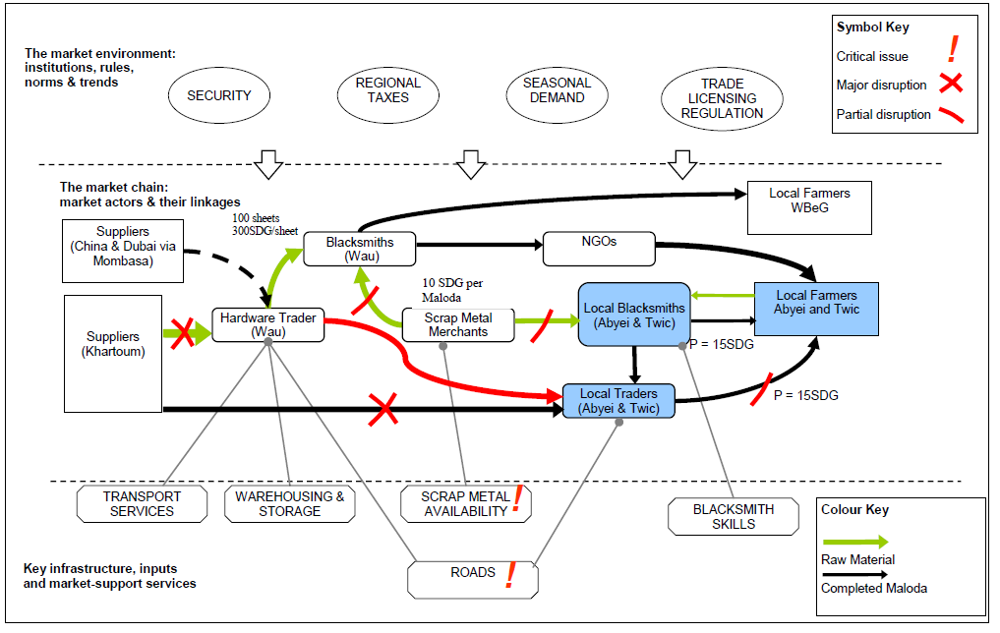
Market responses in South Sudan…
The Maloda Metal Market – emergency map
Notes:
Post crisis, the EMMA found that local production of maloda was inhibited by a decrease in availability of scrap metal and insufficient skills of existing blacksmiths. New metal sheets were found in Wau and were increasingly being used by the blacksmith cooperative there, suggesting that if these sheets could be brought to local markets, they could act as a new raw material for blacksmiths. While the supply lines for metal sheets from Khartoum have been restricted by the closure of the roads, the emergence of new actors, such as China and Dubai, offer opportunities to create alternative supply lines.
The EMMA report stated that, primarily, to enable the market to function better, NGOs should be removed as a market actor. As malodas are not the most effective tool for cultivation, the EMMA also found that any responses to strengthen the maloda market should include activities that address this, such as those that promote behavioural change to using East African hoes or ox ploughs.

Slide 180
The case of Liberia EMMA, April 2011, Influx of refugees from Ivory Coast
Critical questions guiding the EMMA assessment
  Has there been any change in consumer demand as a result of the refugee influx?
  What is the capacity of the imported rice market system to supply the vulnerable people?
  What are the main constraints affecting host communities and refugees to access imported rice?
Implied questions:
  Can people cover their basic food needs (through production, purchase, gifts, aid etc)?
  Ie, is there need for an intervention to support them accessing food?
  If there is need of an intervention to support people to access food, what is relevant and feasible (cash transfers or in kind)?
  Would be food available in markets to answer to a cash /vouchers distribution or will there be need to provide directly food in-kind? Or to combine both modalities?
Target population (for the programme and for the EMMA study)
People most affected by the influx of refugees from Ivory Coast, including
    - Vulnerable households in host communities
    - Refugees
Notes:
Sharing maps
Objective: to understand how maps can convey information about market performance
Resources needed: activity sheets with timber maps, and slide/poster of questions
Share maps from baseline assessments that you are familiar with (preferably the same case study as discussed throughout the training – or use example from Liberia - above).
Indicate how you can see how the market is functioning. Refer to market integration, supply and demand, power and infrastructure. Elicit what the maps are showing. Ask participants to suggest responses from what they can read in the maps. Share the responses from the actual baseline assessment carried out.

Slide 181
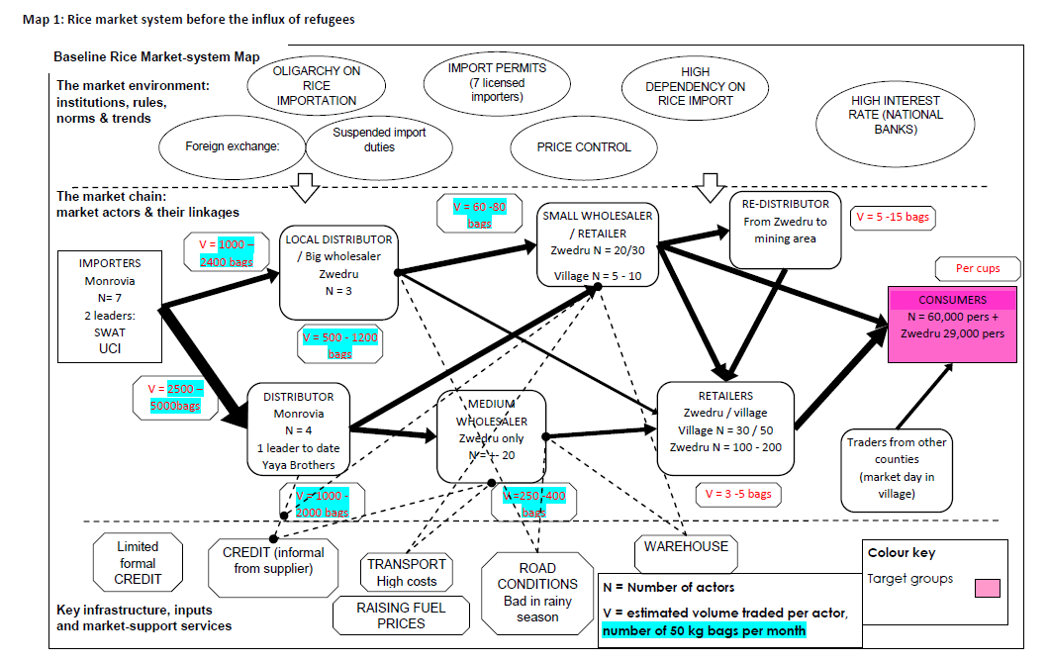
Liberia EMMA – baseline map (before refugee influx)
Notes:
The map is one of the 4 products from the EMMA with the seasonal calendar, the HH gap analysis (what are the needs that people will not be able to cover by themselves) and the response options framework (list of response options with an analysis of their timing, probability and risks).
It represents the functioning of the market: actors, their relationships (power relations), the volumes, and flows. The analysis also includes the seasonality in the functioning.
The level of analysis depends on the time available and the information needs for program design.

Slide 182
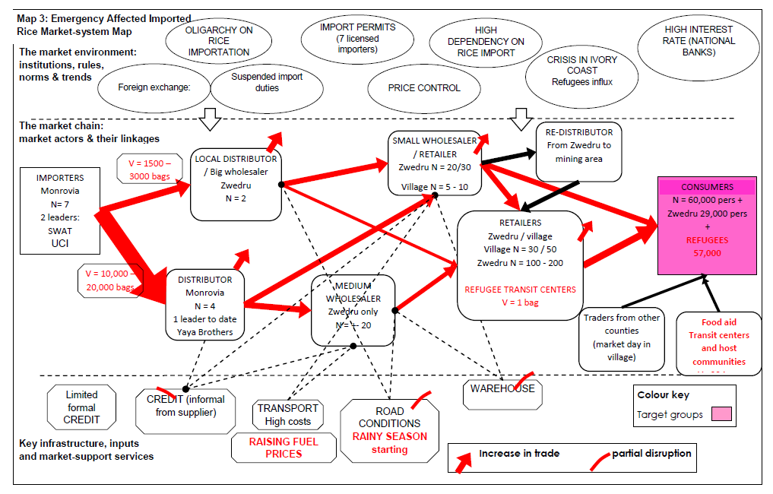
EMMA Liberia – Map after the shock
Notes:
Ask participants what changes they see in the maps (importers much stronger – impact on who...?)

